Slide 1
Searching Federal Debarment
https://sam.gov/content/home
SLS Updated 10/2021

Slide 2
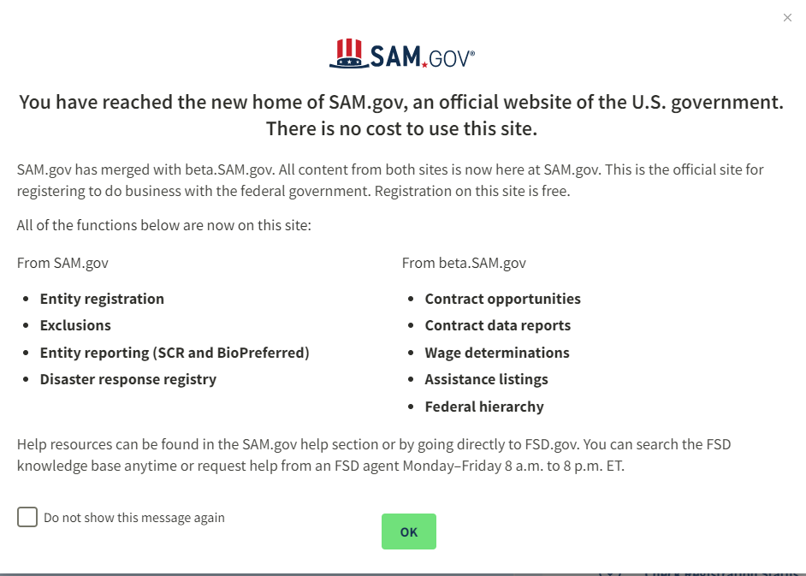
Click on box – will not show message again, then hit OK

Slide 3
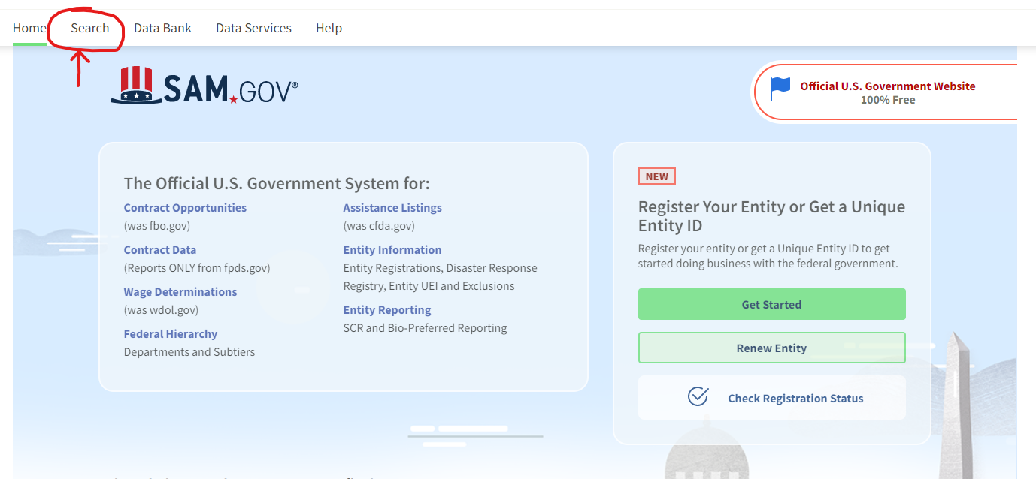

Slide 4
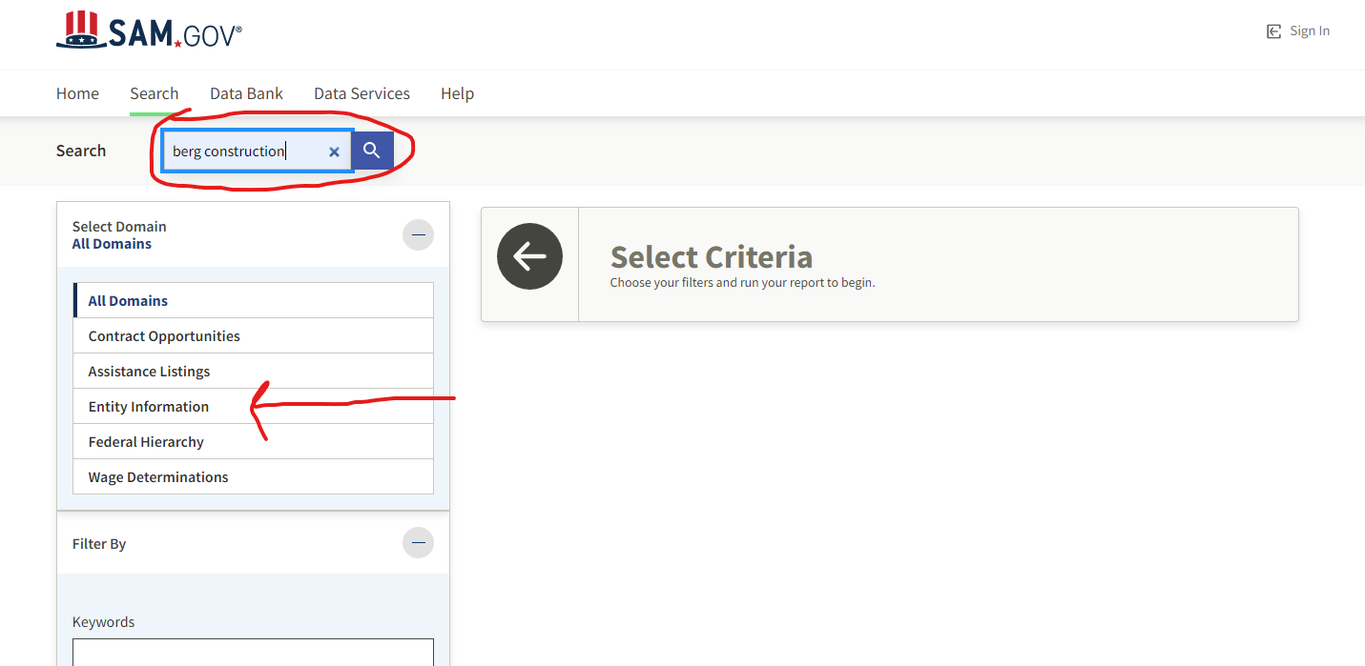
1) Enter vendor name.
2) Click on Entity Information.

Slide 5
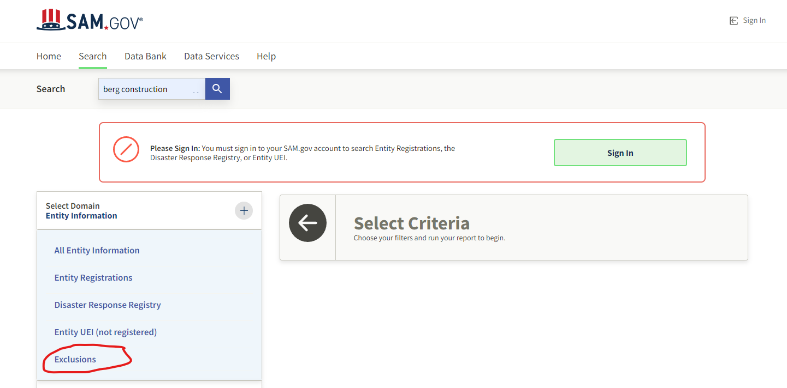
2. Click on search next to vendor name.
You do not need to sign in to view Exclusions (debarment/suspensions).
1. Click on Exclusions then search (see Number 2 above).

Slide 6
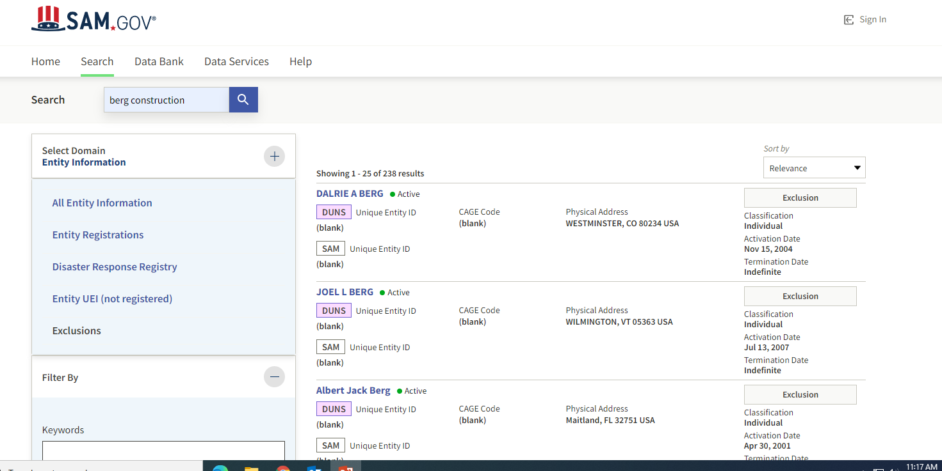
If your vendor is listed, click on their name in DARK BLUE for details.

Slide 7
Debarment/Suspension Final Step
If vendor appears on the list, notify the Director of Purchasing for further instructions.
If vendor does not appear on the list, your task is complete.

