Slide 1
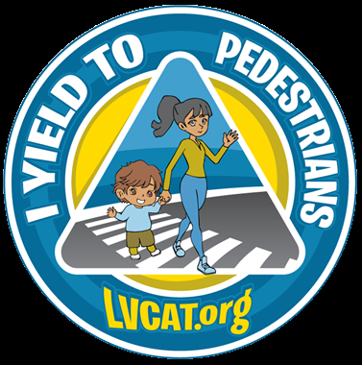
Yield to Pedestrians
Slow Down, Look Around
For City of Bethlehem
June 1, 2023

Slide 2





CAT’s Mission
CAT strengthens our Lehigh Valley community and our environment through bicycling, pedestrian accessibility, and public transportation.
CAT is a 501(c)(3) non-profit organization for education - dedicated to Lehigh and Northampton Counties.

Slide 3
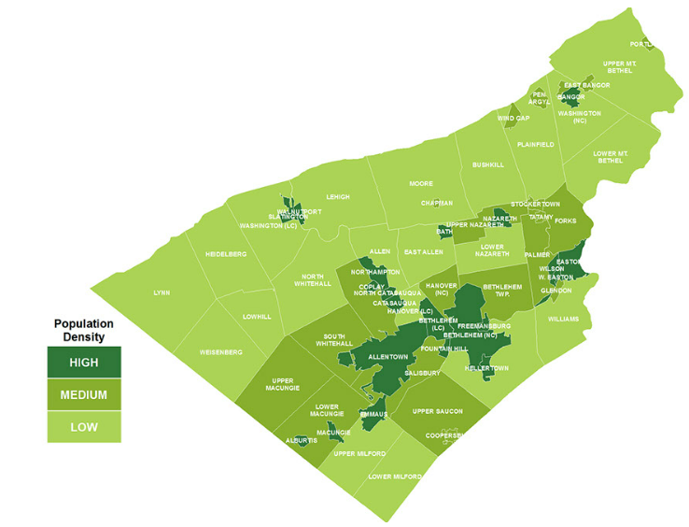
Who does CAT serve?
Lehigh & Northampton Counties
~680,000 residents
62 municipalities
Blend of urban, suburban, rural, warehouses & everything else.
3 cities: Allentown, Bethlehem, Easton (“ABE”)
LVPC is 3rd largest MPO in PA by population
Map courtesy of Lehigh Valley Planning Commission

Slide 4
Who does CAT work with?
Lehigh Valley Planning Commission (our MPO)
PennDOT District 5-0
Counties (Lehigh & Northampton)
City of Bethlehem CTAC
(Citizens Transportation Advisory Committee)
Municipalities (Police, Public Works, Parks, Elected Officials)
Community groups
Local bike shops/clubs & businesses
Local residents

Slide 5
Let’s Talk the Walk
Pedestrian Laws in PA…
Drivers shall yield to pedestrians who are in any marked OR unmarked crosswalk at an intersection
Pedestrians should not “suddenly leave a curb”
“Exercise of care” is the golden rule

Slide 6
7 E’s of Transportation
Education
Engineering
Enforcement
Evaluation
Encouragement
Environment
Equity

Slide 7
Driver
Physiology and Physics
Traffic is a fluid, multi-variable environment
The faster we are driving, the narrower our field of vision
The faster we are driving, the less time we have to react
The faster we are driving, the more stopping distance needed by a 3,000-5,000lb motor vehicle

Slide 8
Reviewing PCIT Data
PennDOT’s Pennsylvania Crash Information Tool (PCIT) is a public database of car-pedestrian crash dataTrends over time (when?)
Geographically and Geometrically (where?)
Related Factors (why?)

Slide 9
PCIT Public Data Limitations
Limitations in crash reporting and public dataset
Speeding might not be indicated unless >10mph over limit
Can’t sort by road speed limit or traffic volume
Doesn’t tell full story about pedestrian

Slide 10
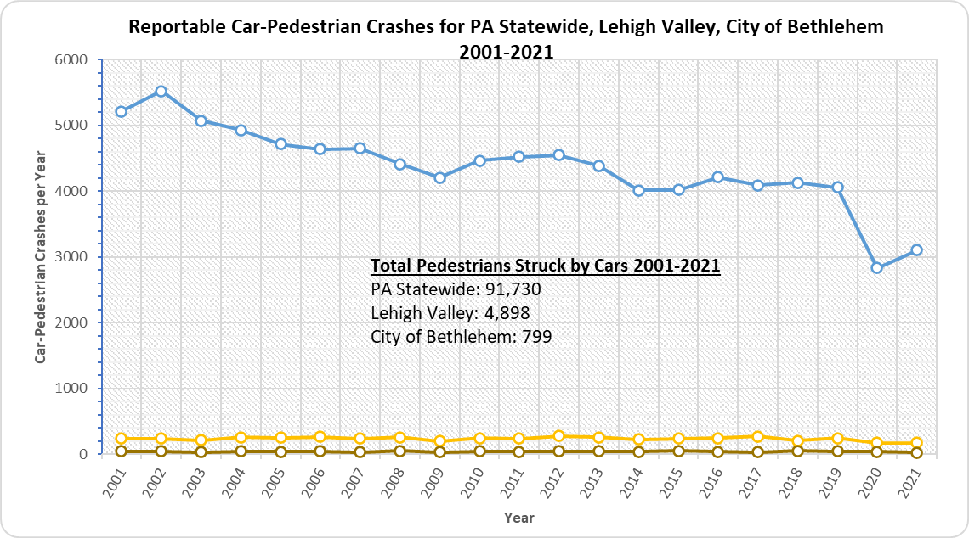
Being a pedestrian in the Lehigh Valley…
Chart data from: crashinfo.penndot.gov/PCIT/queryTool.html#, Retrieved 2-14-2022 & 11-9-2022

Slide 11
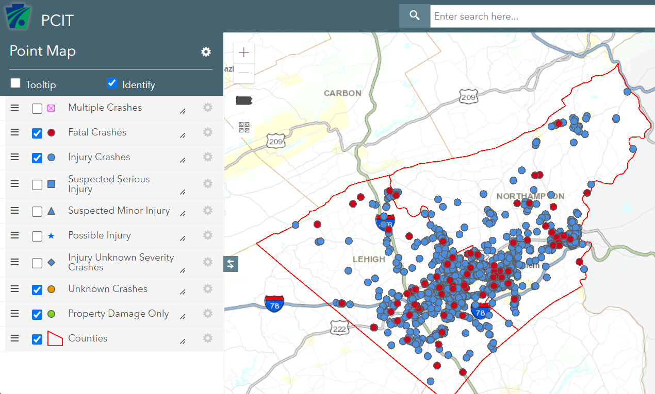
Reportable Car-Pedestrian Crashes in the Lehigh Valley
Lehigh & Northampton Counties (2012-2021)
2,285 car-pedestrian crashes
307 KSI (avg 31 KSI/year)
86 pedestrians killed by cars
Map data from: crashinfo.penndot.gov/PCIT/queryTool.html#, Retrieved 11-9-2022

Slide 12
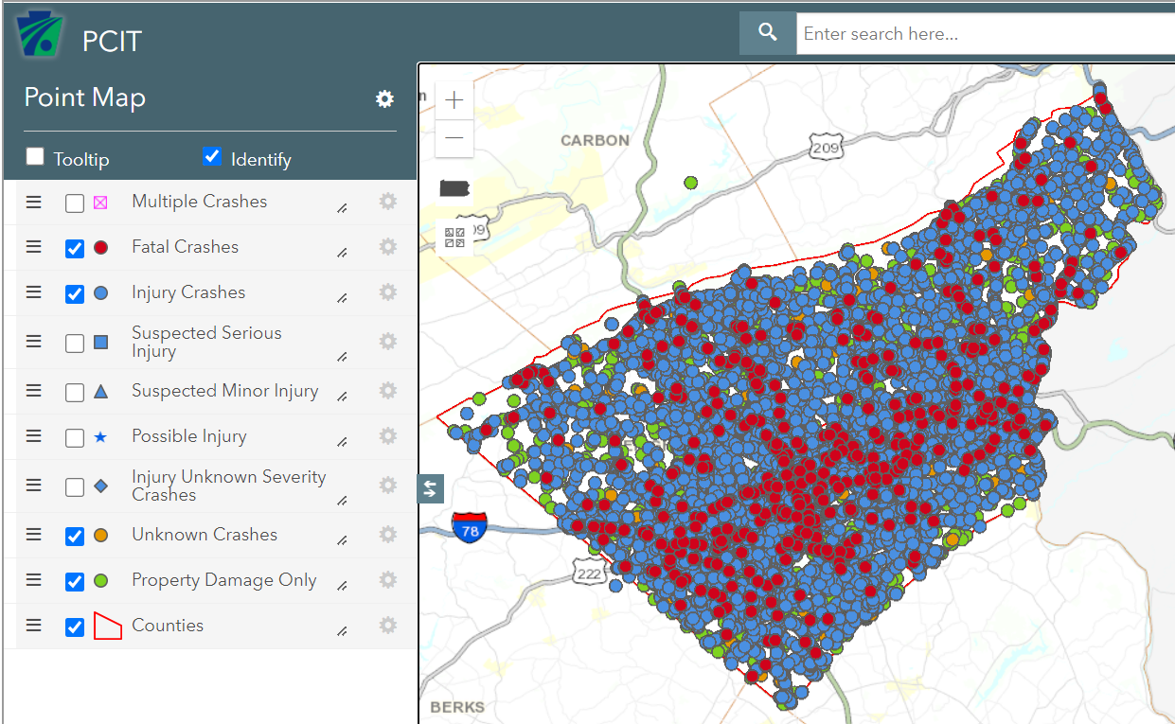
We have a traffic safety problem in the Lehigh Valley (all reportable crashes)
Lehigh & Northampton Counties (2012-2021)
77,241 car-related crashes with
1,946 KSI (avg 195 KSI/year)
489 killed
Map data from: crashinfo.penndot.gov/PCIT/queryTool.html#, Retrieved 11-9-2022

Slide 13
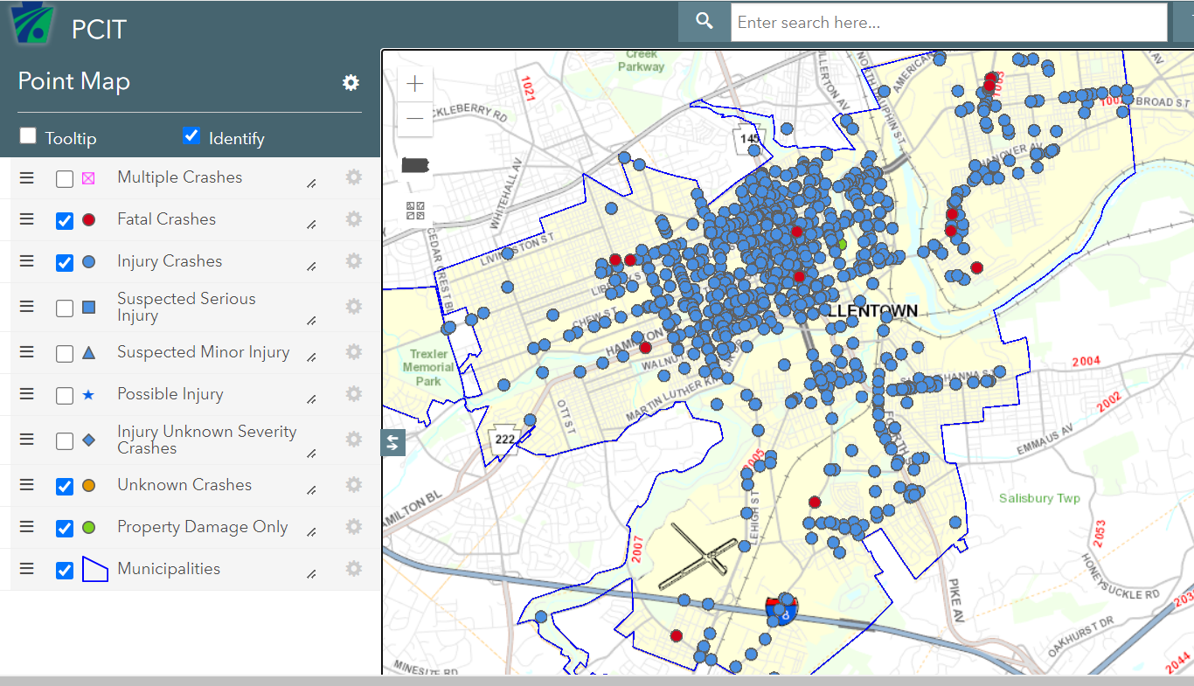
Reportable Crashes with Cars Striking Pedestrians City of Allentown
City of Allentown (2012-2021)
1,153 car-pedestrian crashes with 118 KSI (avg 12 KSI/year)
12 pedestrians killed by cars
Map data from: crashinfo.penndot.gov/PCIT/queryTool.html#, Retrieved 11-9-2022

Slide 14
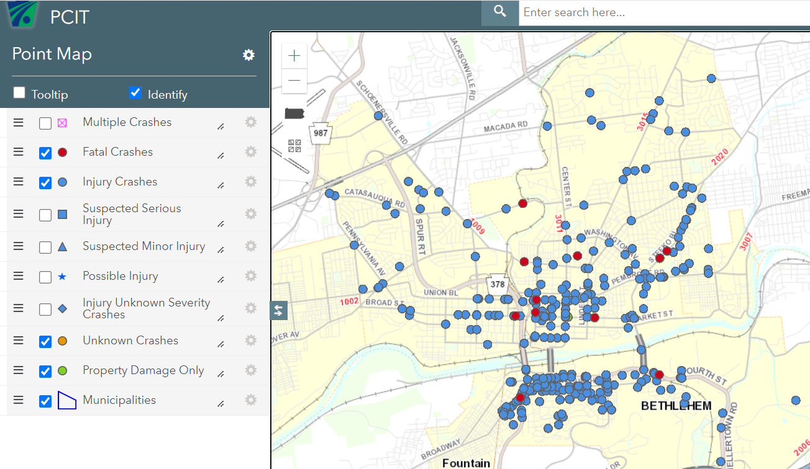
Reportable Crashes with Cars Striking Pedestrians City of Bethlehem - Overall
City of Bethlehem (2012-2021)
380 car-pedestrian crashes with
37 KSI (avg 4 KSI/year)
11 pedestrians killed by cars
Map data from: crashinfo.penndot.gov/PCIT/queryTool.html#, Retrieved 11-9-2022

Slide 15
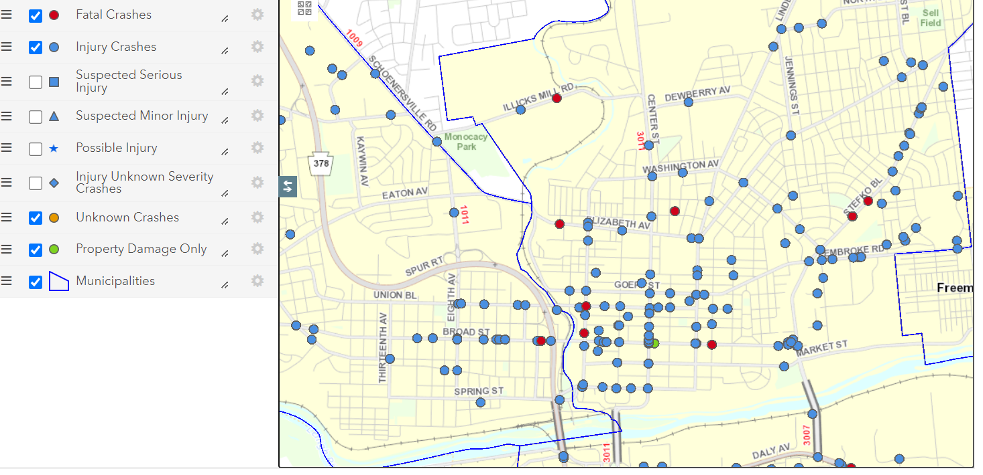
Crashes with Cars Striking Pedestrians
City of Bethlehem - Northside
City of Bethlehem northside crash clusters (2012-2021)
Broad St
Union Blvd
Main St
Center St
Stefko Blvd
Pembroke Rd
Map data from: crashinfo.penndot.gov/PCIT/queryTool.html#, Retrieved 11-9-2022

Slide 16
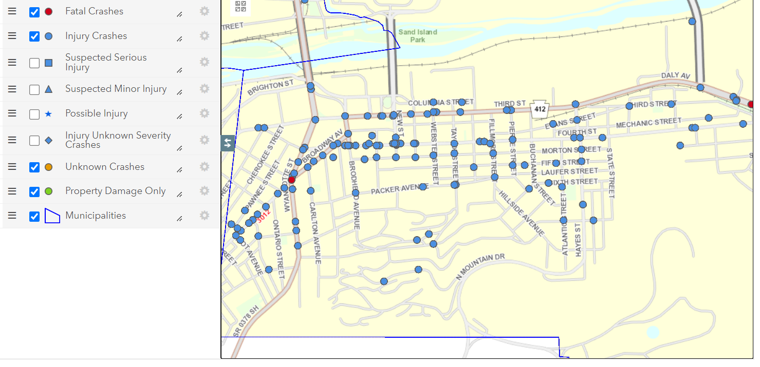
Crashes with Cars Striking Pedestrians
City of Bethlehem - Southside
City of Bethlehem southside crash clusters (2012-2021)
3rd Street/Daly Ave
4th Street
Broadway
Wyandotte St
Map data from: crashinfo.penndot.gov/PCIT/queryTool.html#, Retrieved 11-9-2022

Slide 17
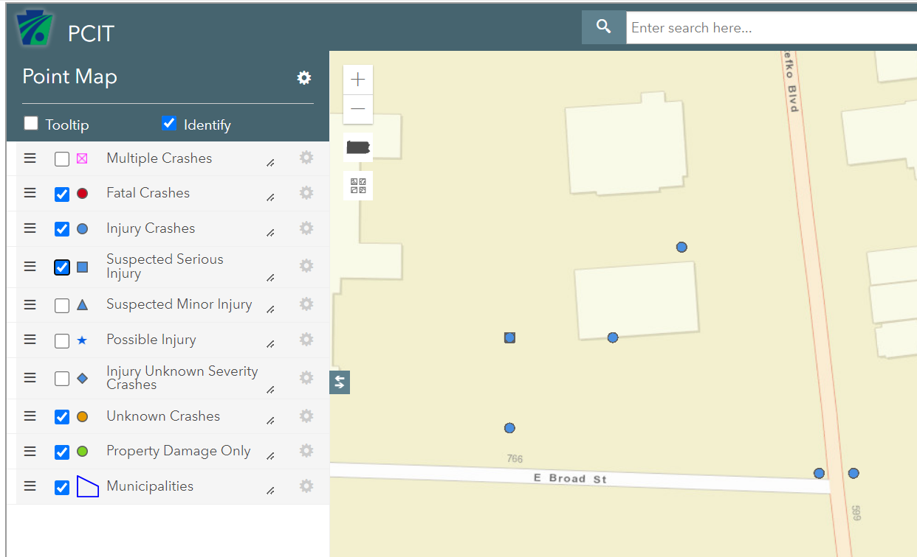
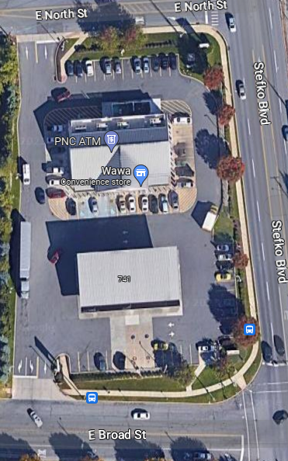
Reportable Crashes with Cars Striking Pedestrian - City of Bethlehem
Wawa
City of Bethlehem (2012-2021)
4 pedestrians hit by motorists in parking lot of Wawa on E Broad St
Map data from: crashinfo.penndot.gov/PCIT/queryTool.html#, Retrieved 2-15-2023

Slide 18
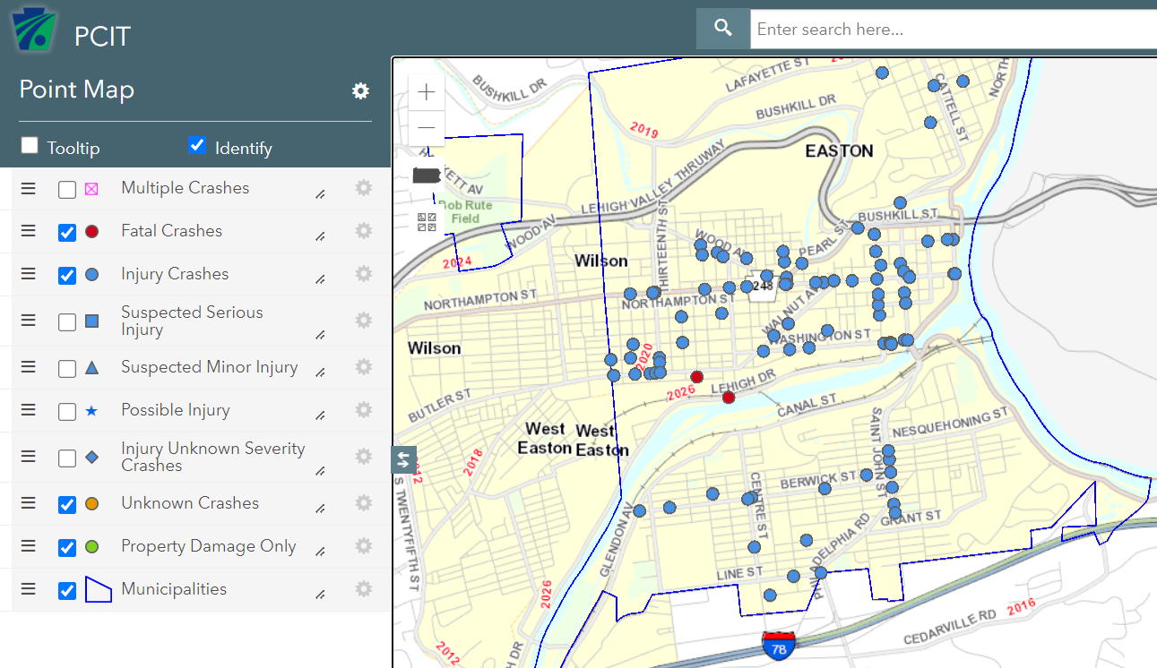
Reportable Crashes with Cars Striking Pedestrians - City of Easton
City of Easton (2012-2021)
102 car-pedestrian crashes with
7 KSI (avg <1 KSI/year)
2 pedestrians killed by cars
Map data from: crashinfo.penndot.gov/PCIT/queryTool.html#, Retrieved 11-9-2022

Slide 19
How can CTAC be involved?
Brainstorming how CTAC can be involved?
Continue Pedestrian Enforcement Program
Conduct enforcement of existing speed limits
Review speed limits on high-crash roadways to see if lower speed limits are warranted
Participate in summer 2023 outreach events

Slide 20
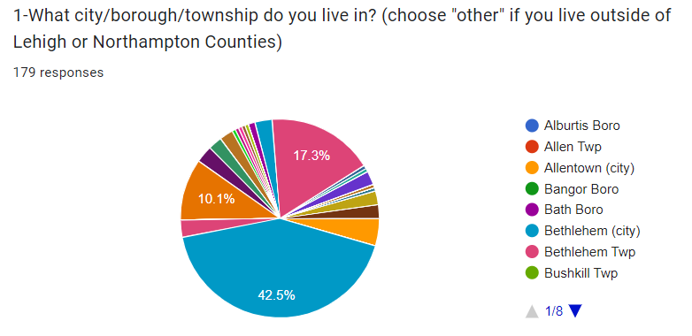
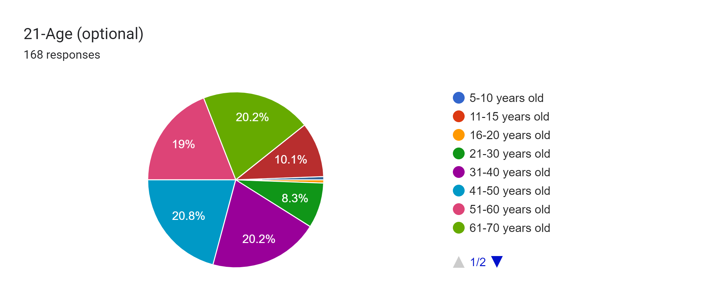
Yield to Pedestrians Survey
Preliminary Data as of 11/9/2022
181 responses from 61 municipalities as of 2/17/2023

Slide 21
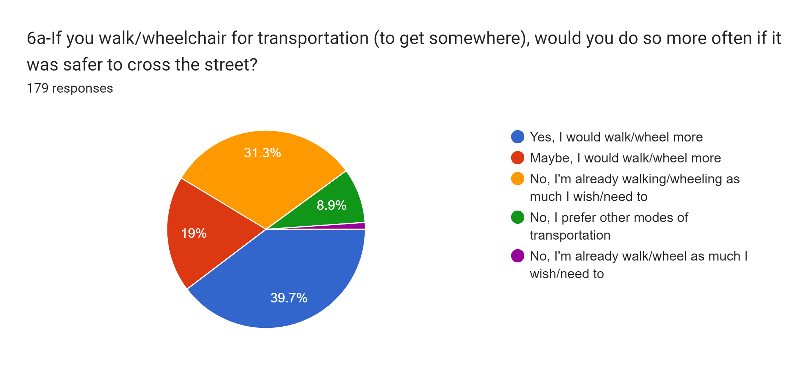
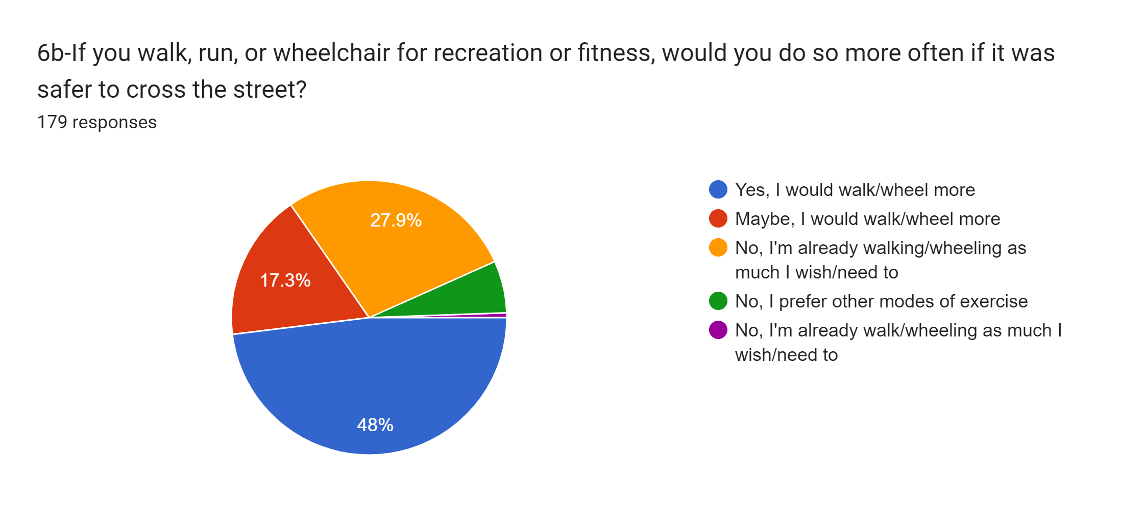
Yield to Pedestrians Survey
Preliminary Data as of 11/9/2022
Recreational pedestrians would walk more if it were “safer”…

Slide 22
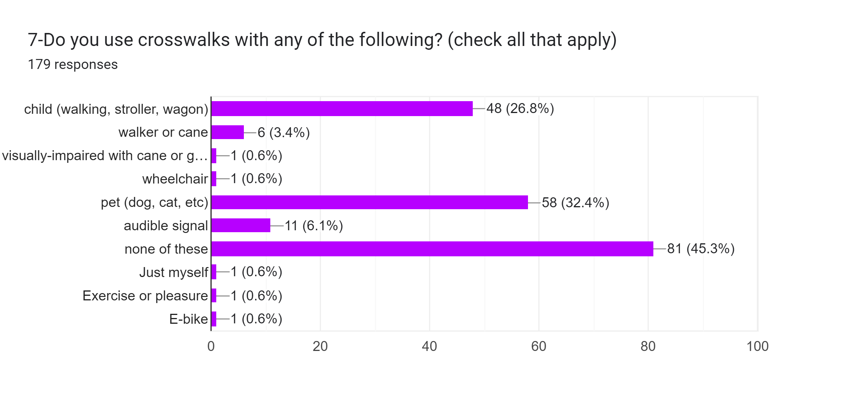
Yield to Pedestrians Survey
Preliminary Data as of 11/9/2022
26% of respondees walk with a child, 38% walk with a pet…

Slide 23
Yield to Pedestrians Survey
Preliminary Data as of 11/9/2022
What people say are the top 5 problems with crosswalks:
54% say “When I push the button I have to wait too long”
48% say “Cars park too close to crosswalk that impair visibility”
46% say “Unmarked crosswalks that I wish were painted”
44% say “Pushbuttons that don't work at all”
38% say “Other obstructions impair visibility at crosswalk (trees/bushes/structures)”

Slide 24
Yield to Pedestrians Survey
Preliminary Data as of 11/9/2022
What people say are the top 3 problems with drivers:
86% say “Drivers don't pay attention”
81% say “Drivers going too fast/speeding”
80% say “Drivers don't yield when I'm in the crosswalk”

Slide 25
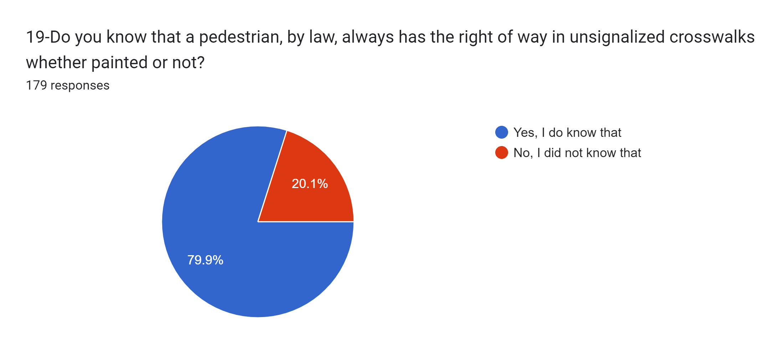
Yield to Pedestrians Survey
Preliminary Data as of 11/9/2022
Only 80% respondees are aware of PA pedestrian laws…

Slide 26
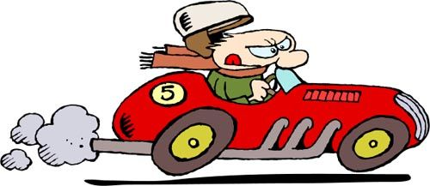
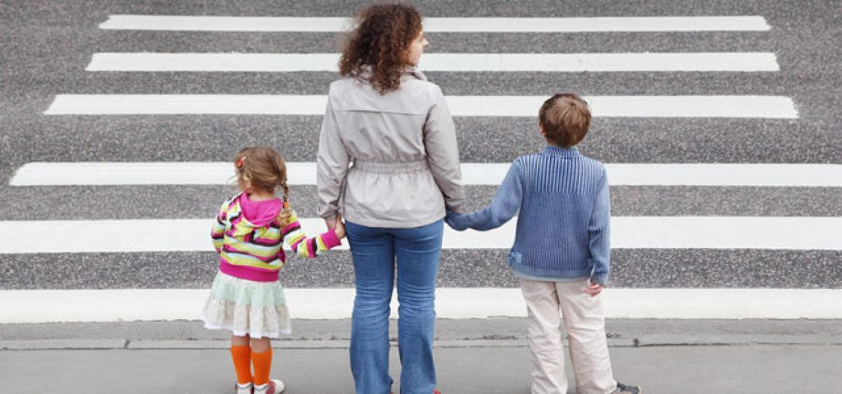
CAT’s
Yield to Pedestrians Initiative

Slide 27
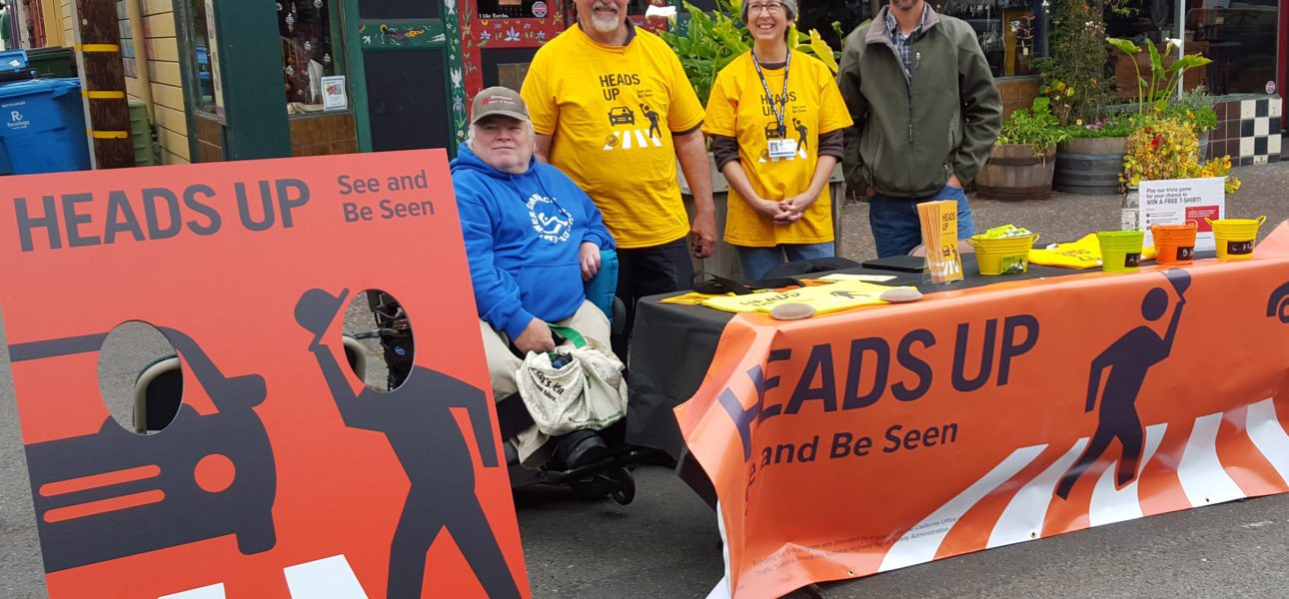
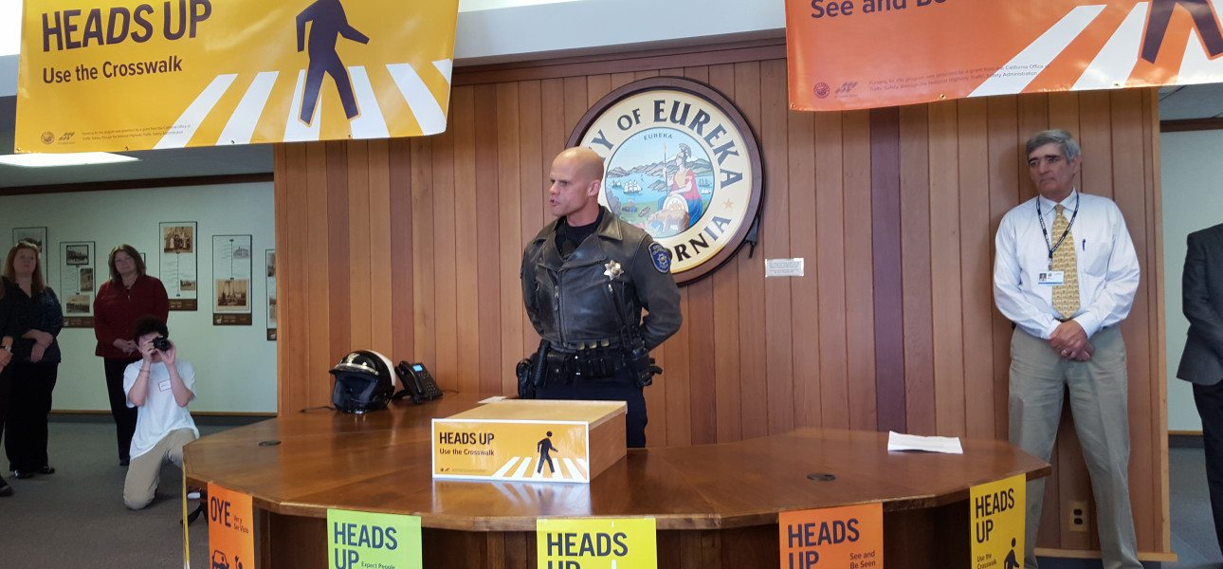
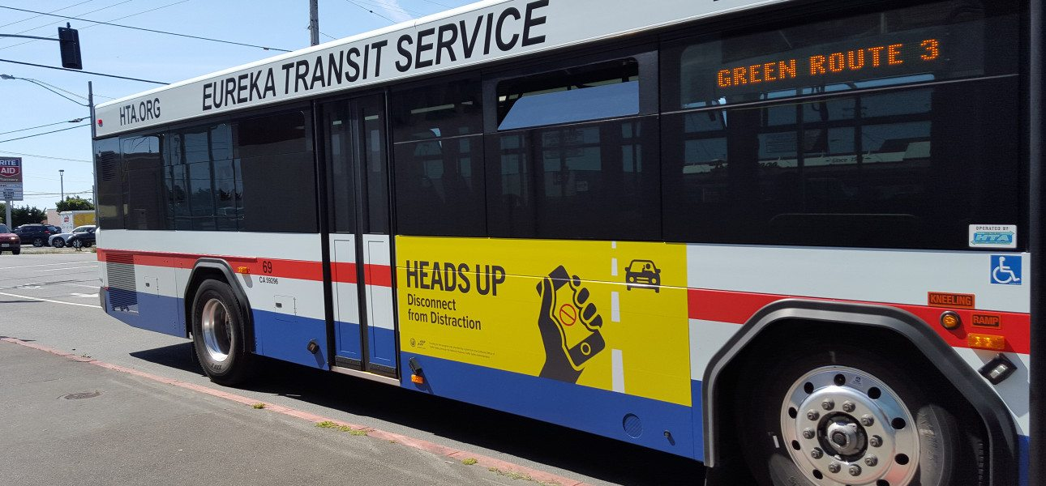
Eureka California
$100,000 CA Grant
Hired Alta Planning + Design

Slide 28
Comments from Pedestrian Program in Eureka, CA
“I now drive slower through town, and keep a look out for
people who cross in the middle of the road, not at the
intersection. You can never be too safe and aware of your responsibilities behind the wheel. My favorite part of this whole campaign was making people more aware that just seconds of not paying attention can be deadly”

Slide 29
Results from Pedestrian Program in Eureka, CA
When asked about the impact of the campaign, the survey respondents who expressed an opinion stated the following:
81% think the campaign was somewhat or very successful at meeting its goal of enhancing public safety for
all modes of transportation.
89% think there is value in continuing a campaign like Heads Up.
65% agree that drivers, in general, are more aware of pedestrians now compared to before the campaign.
65% think they themselves are more aware of pedestrians when driving.
47% say they have changed their habits while driving (such as not texting or using a cell phone, yielding to
pedestrians, etc.) following the campaign.
63% agree that pedestrians are more aware of drivers now compared to before the campaign.
36% think they are more aware of drivers when walking.
37% say they have changed their habits when walking (such as not texting or looking at their phones, looking for
cars before crossing, etc.)

Slide 30

Slow Down, Look Around
Yield to Pedestrians, It’s the Law
CAT’s Initiative
“I Yield to Pedestrians”
“Seen and Be Seen

Slide 31

Positive Messages
…

Slide 32
Positive Messages

Slide 33
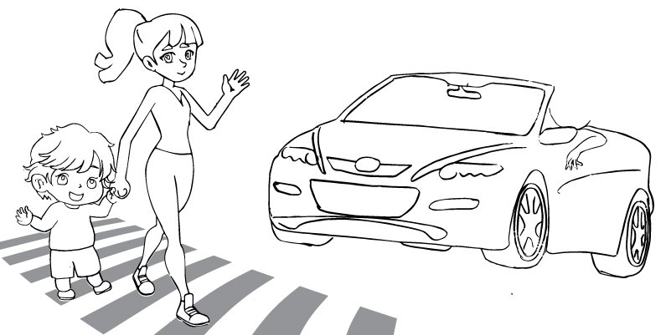
CAT Street Banner Concept

Slide 34
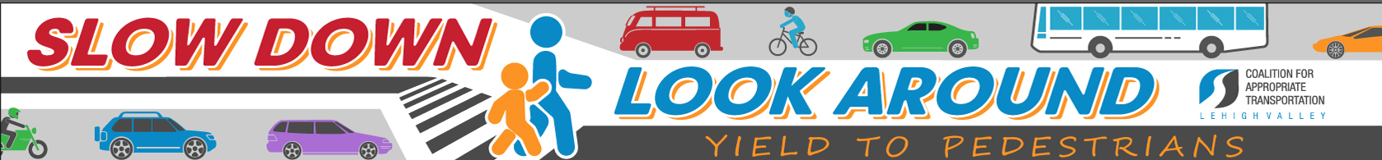
CAT Street Banners

Slide 35
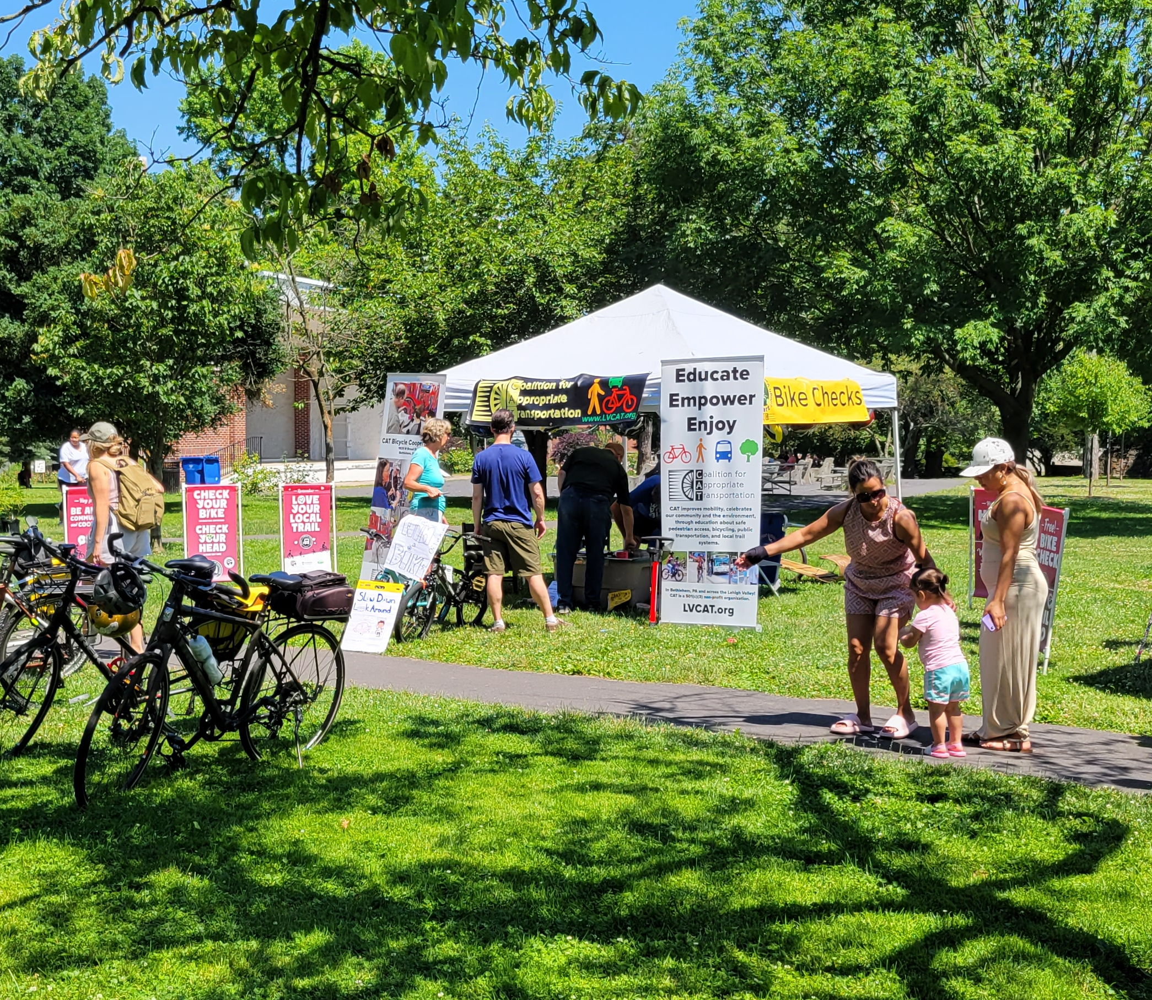
Opening Day Event!
June 10, 2023
Rose Garden Park Bethlehem, PA
A celebration of walking, wheeling, the original and most fundamental form of transportation
Carnival style pedestrian themed activities with prizes.
Educational material
Free swag
T-Shirts
Photo Board
Family Fun

Slide 36
Activities to continue throughout the summer.
Radio Segments
Weekly presence Farmers Markets and other local events
Signage Downtown Businesses
Group Walks
Enforcement

Slide 37
Discussion

Slide 38
Learn more about CAT
Call: 610-954-5744
Email: cat@lvcat.org
Visit: 1935 W Broad St, Bethlehem, PA 18018
Web: LVCAT.org facebook.com/lvcat/ instagram.com/cat_lehighvalley

Slide 39
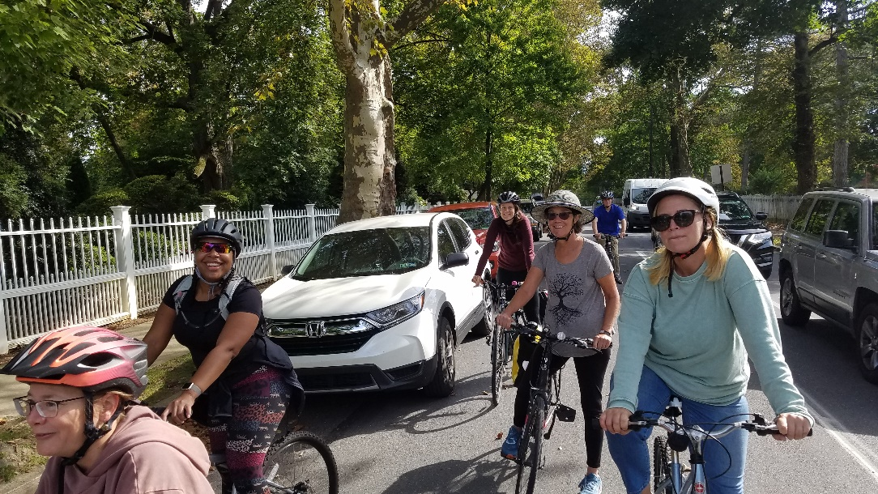
CAT means choices…

Slide 40
What helps pedestrians?
Traffic calming roads designed for 15-25mph in pedestrian areas
Automated speed enforcement (limited in PA)
Continuing education for drivers (limited in PA)
High-visibility crosswalks
Snow/ice-free sidewalks and crosswalks
Streetlights that illuminate crosswalks but don’t create glare for drivers
A culture shift that normalizes pedestrians, not cars

Slide 41

Instead of seeing this on our streets…

Slide 42
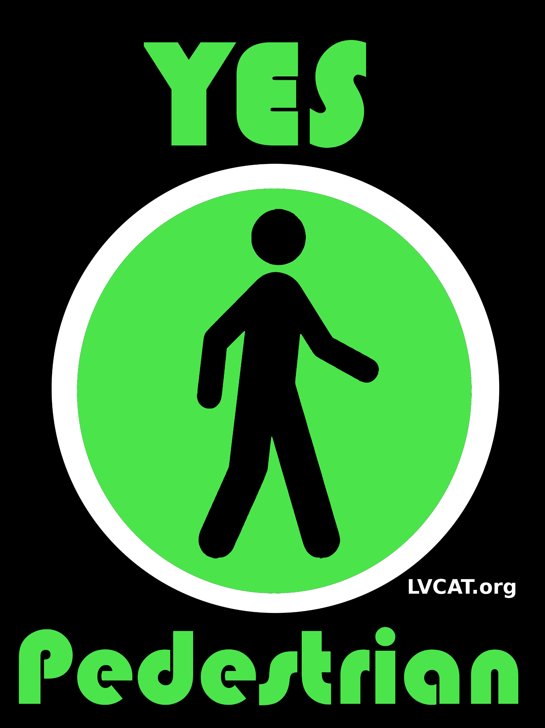
Let’s see this…

