Slide 1
City of Bethlehem
Land Development Process
Community Development Committee Meeting
June 28, 2022

Slide 2
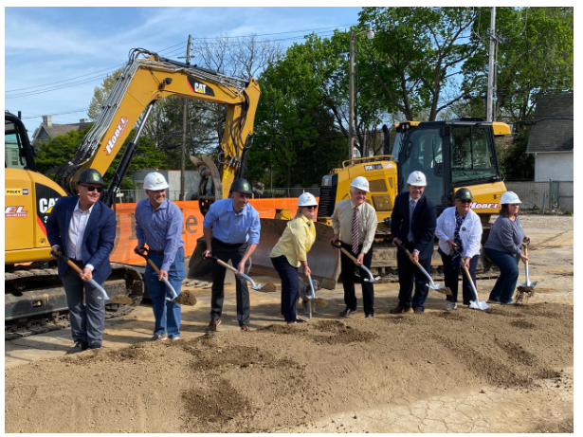
INTRODUCTION

Slide 3
Governing Ordinances/Statutes
Municipal Planning Code (PA)
Bethlehem Subdivision and Land Development Ordinance
Bethlehem Zoning Ordinance
Articles covering Bethlehem’s Historic Districts
Article 1713, Historic Bethlehem
Article 1714, Historic Conservation District South Bethlehem and Mount Airy

Slide 4
Guiding Principles
Encourage traditional neighborhood development that promotes infill development compatible with the best features of older neighborhoods.
Promote adaptive reuse and historic preservation, where appropriate, to retain character of existing structures.
Allow and encourage a wide variety of housing types to provide a range of housing opportunity for residents.
Preserve and strengthen Bethlehem’s role as a major commercial, institutional, and industrial job center in the Lehigh Valley with a focus on technology, retail, office, and service uses.
Adapt to evolving market needs and demands.
Ensure that development complies with recommendations of the Bethlehem Climate Action Plan (CAP), including protection of natural resources and the encouragement of sustainable development.
Ensure new development addresses all traffic impacts, including vehicular, pedestrian, bike, and transit.

Slide 5
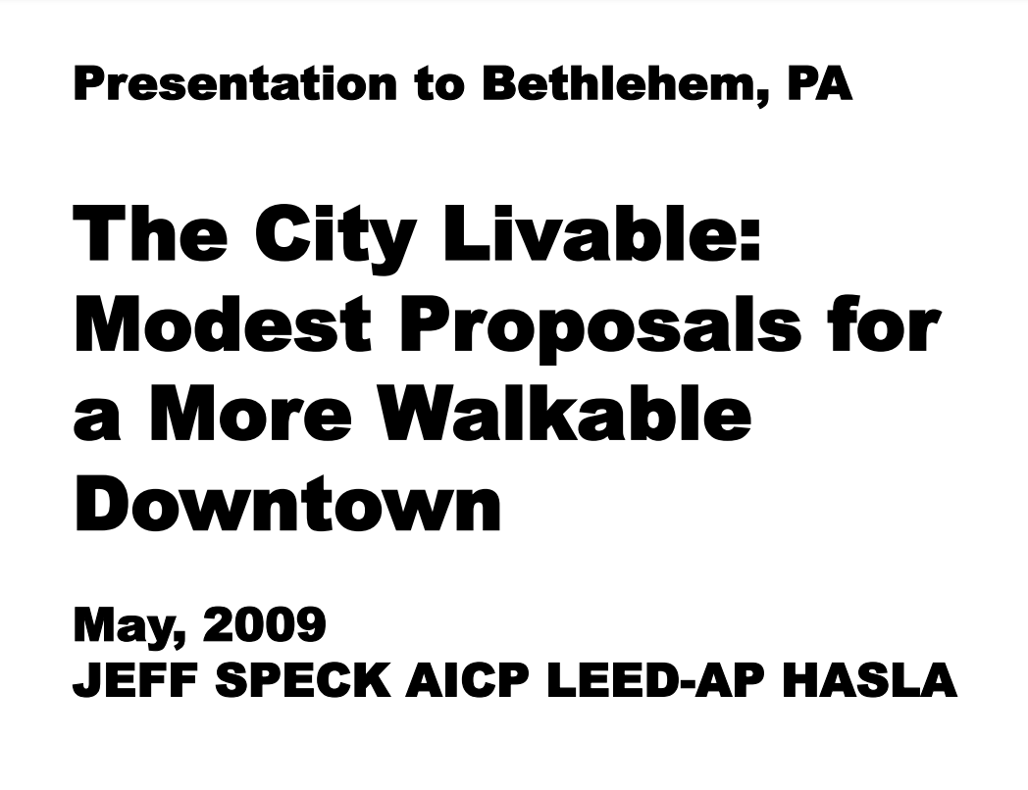
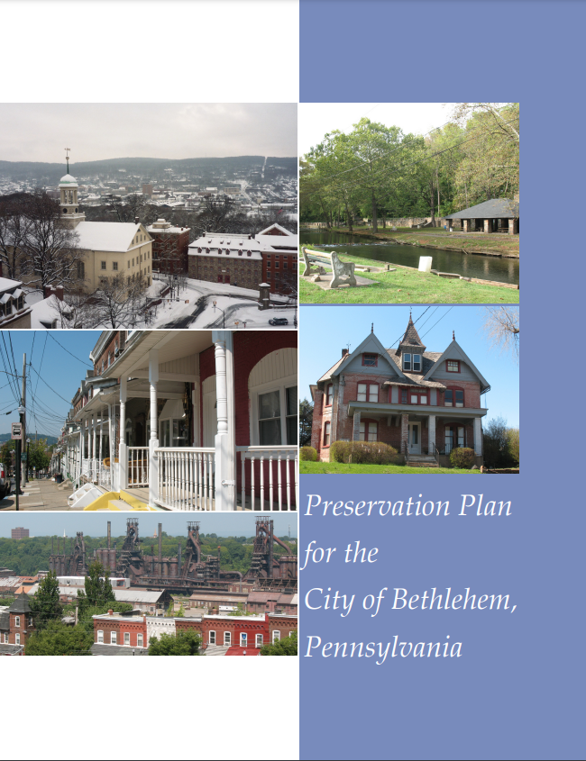
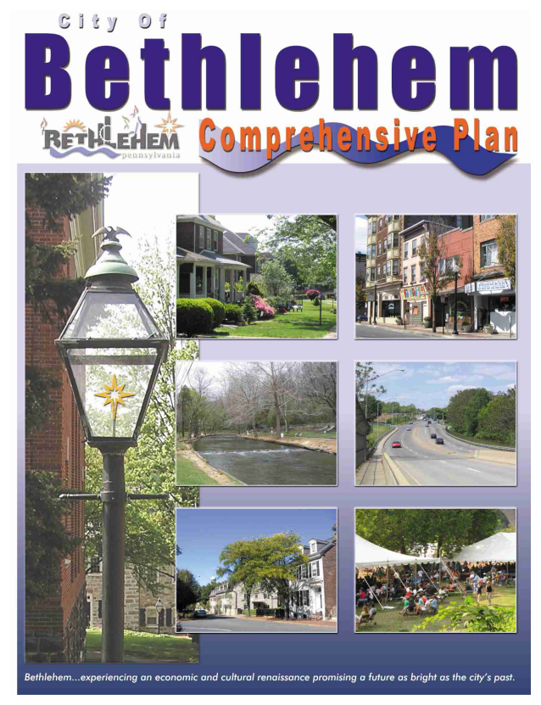
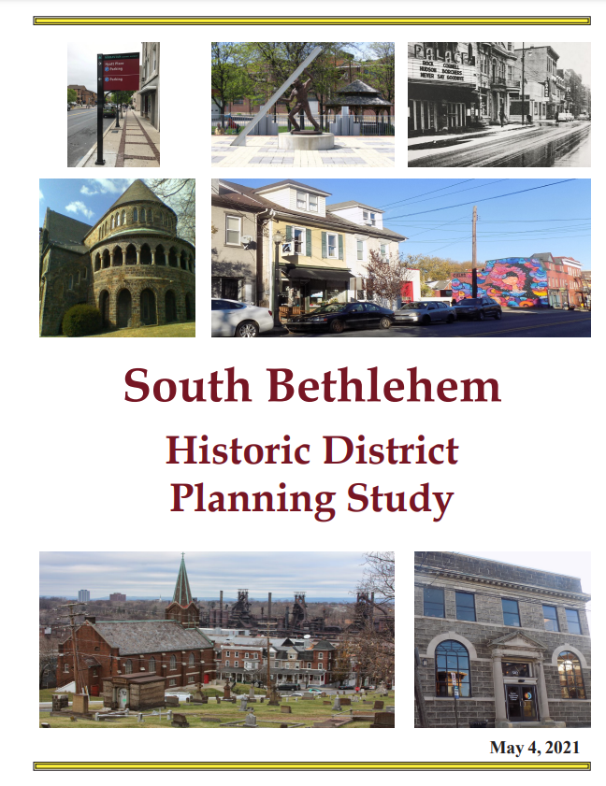
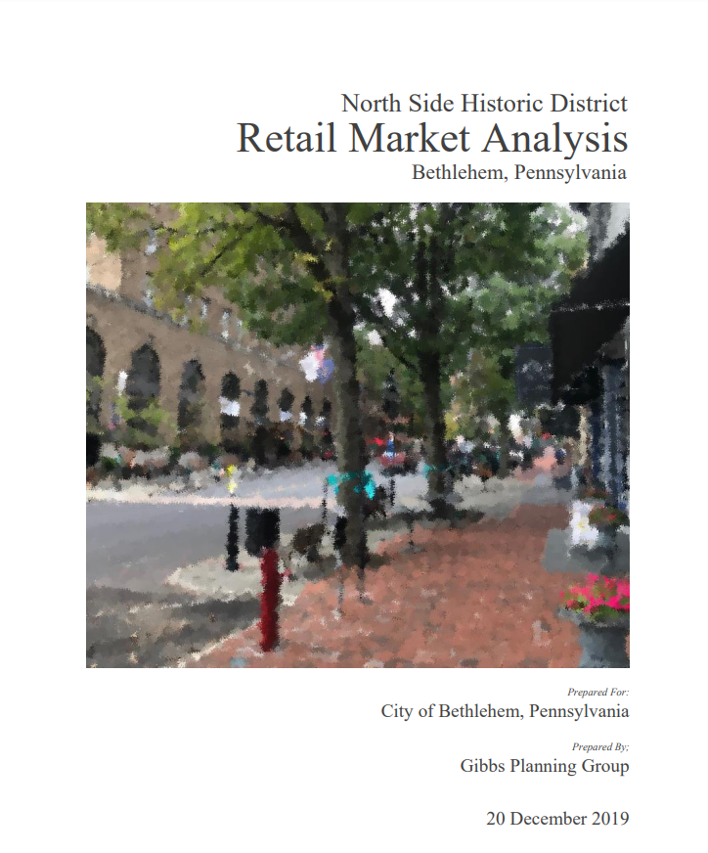
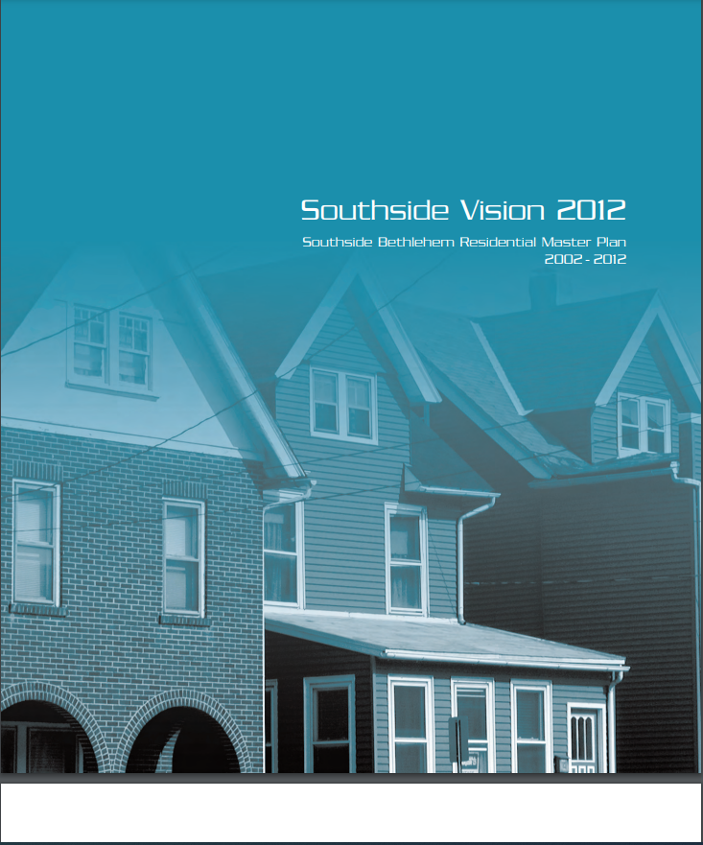
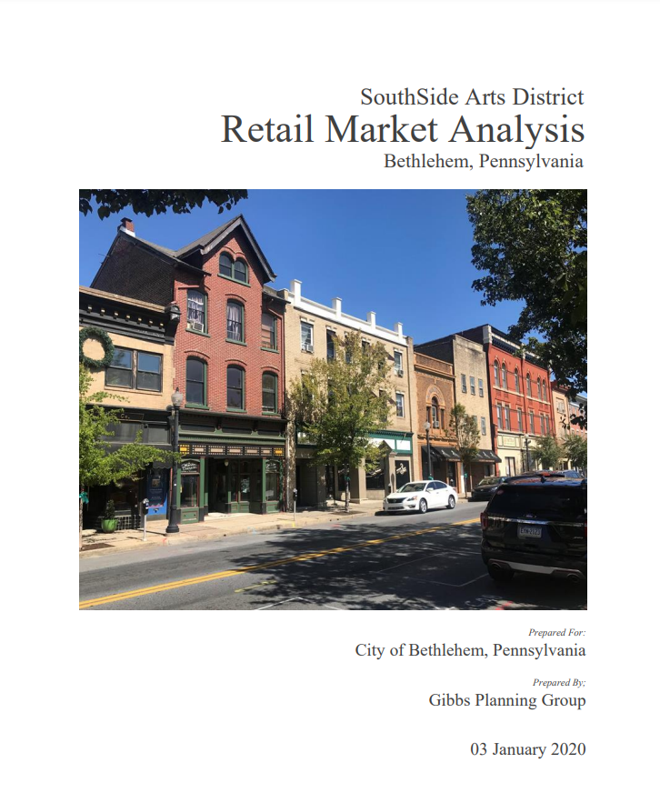
Planning
Comprehensive Plan
Community Plans

Slide 6
What is land development?
Land Development. Land Development shall include any of the following activities, unless such definition is revised by a later amendment of the Pennsylvania Municipalities Planning Code:
1. The improvement of 1 or 2 or more contiguous lots, tracts or parcels of land for any purpose involving either or both of the following:
a. A group of 2 or more residential or nonresidential buildings, whether proposed initially or cumulatively, or a single principal nonresidential building on a lot or lots regardless of the number of occupants or tenure, or
b. The division or allocation of land or space, whether initially or cumulatively, between or among 2 or more existing or prospective occupants by means of, or for the purpose of, streets, common areas, leaseholds, condominiums, building groups, or other features.
2. A subdivision of land.

Slide 7
Process
Developer has a project plan
Does the project require zoning relief?
City Zoning Officer
Zoning Hearing Board
City staff review
City Departments
Does the project need a Certificate of Historical Appropriateness?
HCC/HARB
City Council
Final Approval
City Planning Commission
Third-party review
Outside Entities
Notes:
EIT, LST, BPT provided by TriState & Keystone Collections
Real Estate Taxes assumes collection of 100% of Real Estate Taxes generated from LERTA Projects and Current Millage Rates.
Assessment information pulled from COB and NCPub

Slide 8
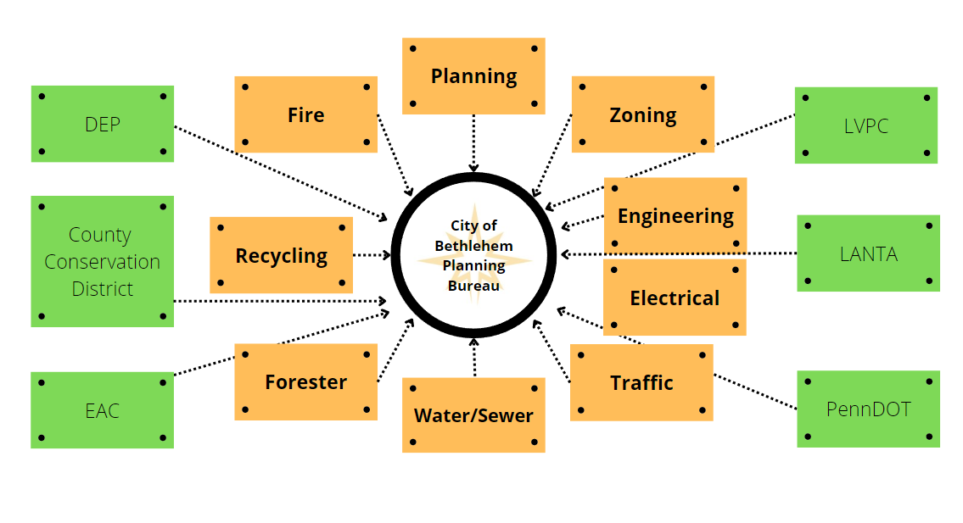
Notes:
EIT, LST, BPT provided by TriState & Keystone Collections
Real Estate Taxes assumes collection of 100% of Real Estate Taxes generated from LERTA Projects and Current Millage Rates.
Assessment information pulled from COB and NCPub

Slide 9
Traffic Considerations
Based on the latest edition of Institute for Transportation Engineers (ITE) Trip Generation Manual:
If proposed vehicle trips in the peak hour are between 1 and 50, then no traffic study is required.
If the proposed development is expected to result in more than 50 and up to 100 new vehicle trips in the peak hour, then an abbreviated traffic study is required.
If proposed development is expected to result in 100 trips or more in the peak hour then a full traffic study, pedestrian safety analysis and traffic calming measures are required.

Slide 10
Climate Action Plan Considerations
Goals
Reduce paving and increase greenspace
Enhance pedestrian, bike, and transit infrastructure
Calm traffic, increase pedestrian safety
Require native species
Increase/enhance options for green infrastructure
SALDO Revisions
Notes:
Construction of 180k sq. ft. facility
Manufacturer
$13 million investment
96 Full –time employees
Curtiss-Wright is a national defense contract and their Engineered Pump Division, formerly located in Phillipsburg, makes marine pumps for use in engine rooms of surface and sub-surface vessels.

Slide 11
Questions?

