Slide 1


Pennsylvania State Ethics Commission
65 Pa.C.S.§ 1101 et seq.
Jeffery S. Frankenburger
Supervising Investigative Counsel
Notes:
Welcome to this brief introduction on the history and Purpose of the Public Official and Employee Ethics Act. My name is Jeff Frankenburger. I am the Assistant Counsel for the Investigative Division. We hope that this lesson teaches you a little bit about what the Ethics Commission is, and what role it has to play in this Commonwealth.

Slide 2
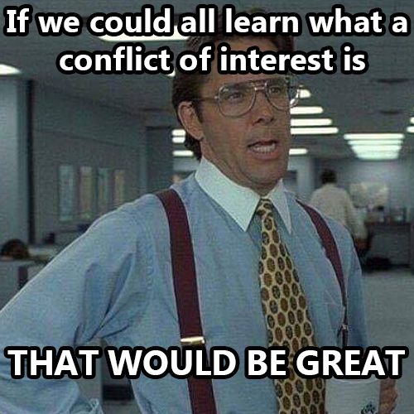

Slide 3
Three Primary Functions
Investigations
Statements of Financial Interests
Advices and Opinions
Notes:
Receiving and Reviewing Statements of Financial Interests
Issuing prospective advisory opinions regarding an individuals duties and responsibilities under the Ethics Act
Investigating Violations of the Ethics Act, holding hearings, and issuing decisions in relation to said investigations
Preparing and publishing an annual report, special reports, and educational materials.

Slide 4

Advices and Opinions
From 2015 - 2020
451
Advices/Opinions Issued
Notes:
These advices and opinions are an instrumental tool in guiding public officials and public employees both current and future.

Slide 5

Public Official
Elected by the public
Appointed by a governmental body
Appointed official
Any political subdivision

Slide 6

Public Employee
  Employed by the Commonwealth or a political subdivision
  Responsible for taking or recommending official action of a non-ministerial nature with regard to:
  Contracting or procurement; Administering or monitoring grants or subsidies
  Planning or zoning; Inspecting, licensing, regulating or auditing any person, or
  Any other activity where the official action has an economic impact of greater than a de minimis nature on the interests of any person”

Slide 7

RESTRICTED ACTIVITIES:

Slide 8

No public official or public employee shall engage in conduct that constitutes a conflict of interest.
This Photo by Unknown Author is licensed under CC BY-SA-NC

Slide 9
Conflict of Interest – Ethics Act Definition
Use of Authority of Office
Or Confidential Information
For the private pecuniary benefit
Themselves, a member of their immediate family, or a business with which they are associated
1
2
3
4

Slide 10
Authority of Office or Employment
Actual Power
Provided by Law
Necessary to performance of duty or responsibility

Slide 11

A pecuniary benefit or must be financial.
Fair Market Value and/or Face Value
Commonwealth v. Veon, 637 Pa. 442, 460, 150 A.3d 435, 446 (2016)

Slide 12
Immediate Family
Parent
Child
Sibling
Spouse

Slide 13
Business With Which Associated
Any Business
Or an Immediate Family Member
Director, Officer, Owner, Employee, or Financial Interest
That the Public Official

Slide 14
EXCEPTIONS
Action having a de minimis economic impact
Affects to the same degree a class consisting of the general public
Subclass consisting of an industry, occupation, or other group

Slide 15
Frequent Conflict
Of Interest Issues
Excess Expense
Frequent Point Program
Discount Program Offer
Vendor Contest
Surplus Property
Gifts/Travel Provided by Vendor Contractor
Solicitations by Superiors/Regulators
Private business enterprise
Charter schools
Use of Personnel, Equipment, Facilities
Nepotism
Grant Fund Manipulation
Perjury

Slide 16

Borough Manager
Utilized Borough CC for unauthorized purchases
Golf/Meals/Clothing
Excessive mileage/fuel reimbursements when using Borough fuel
A whole bunch of SFI issues
Lynch, Order 1767

Slide 17

Bribery

Slide 18
Improper Influence 1103(b) and (c)
No public official, public employee shall solicit or accept OR
No person shall offer or give
1
2
3
4
Anything of monetary value
With the understanding
That the vote, official act, or judgement of the public official
Will be influenced

Slide 19
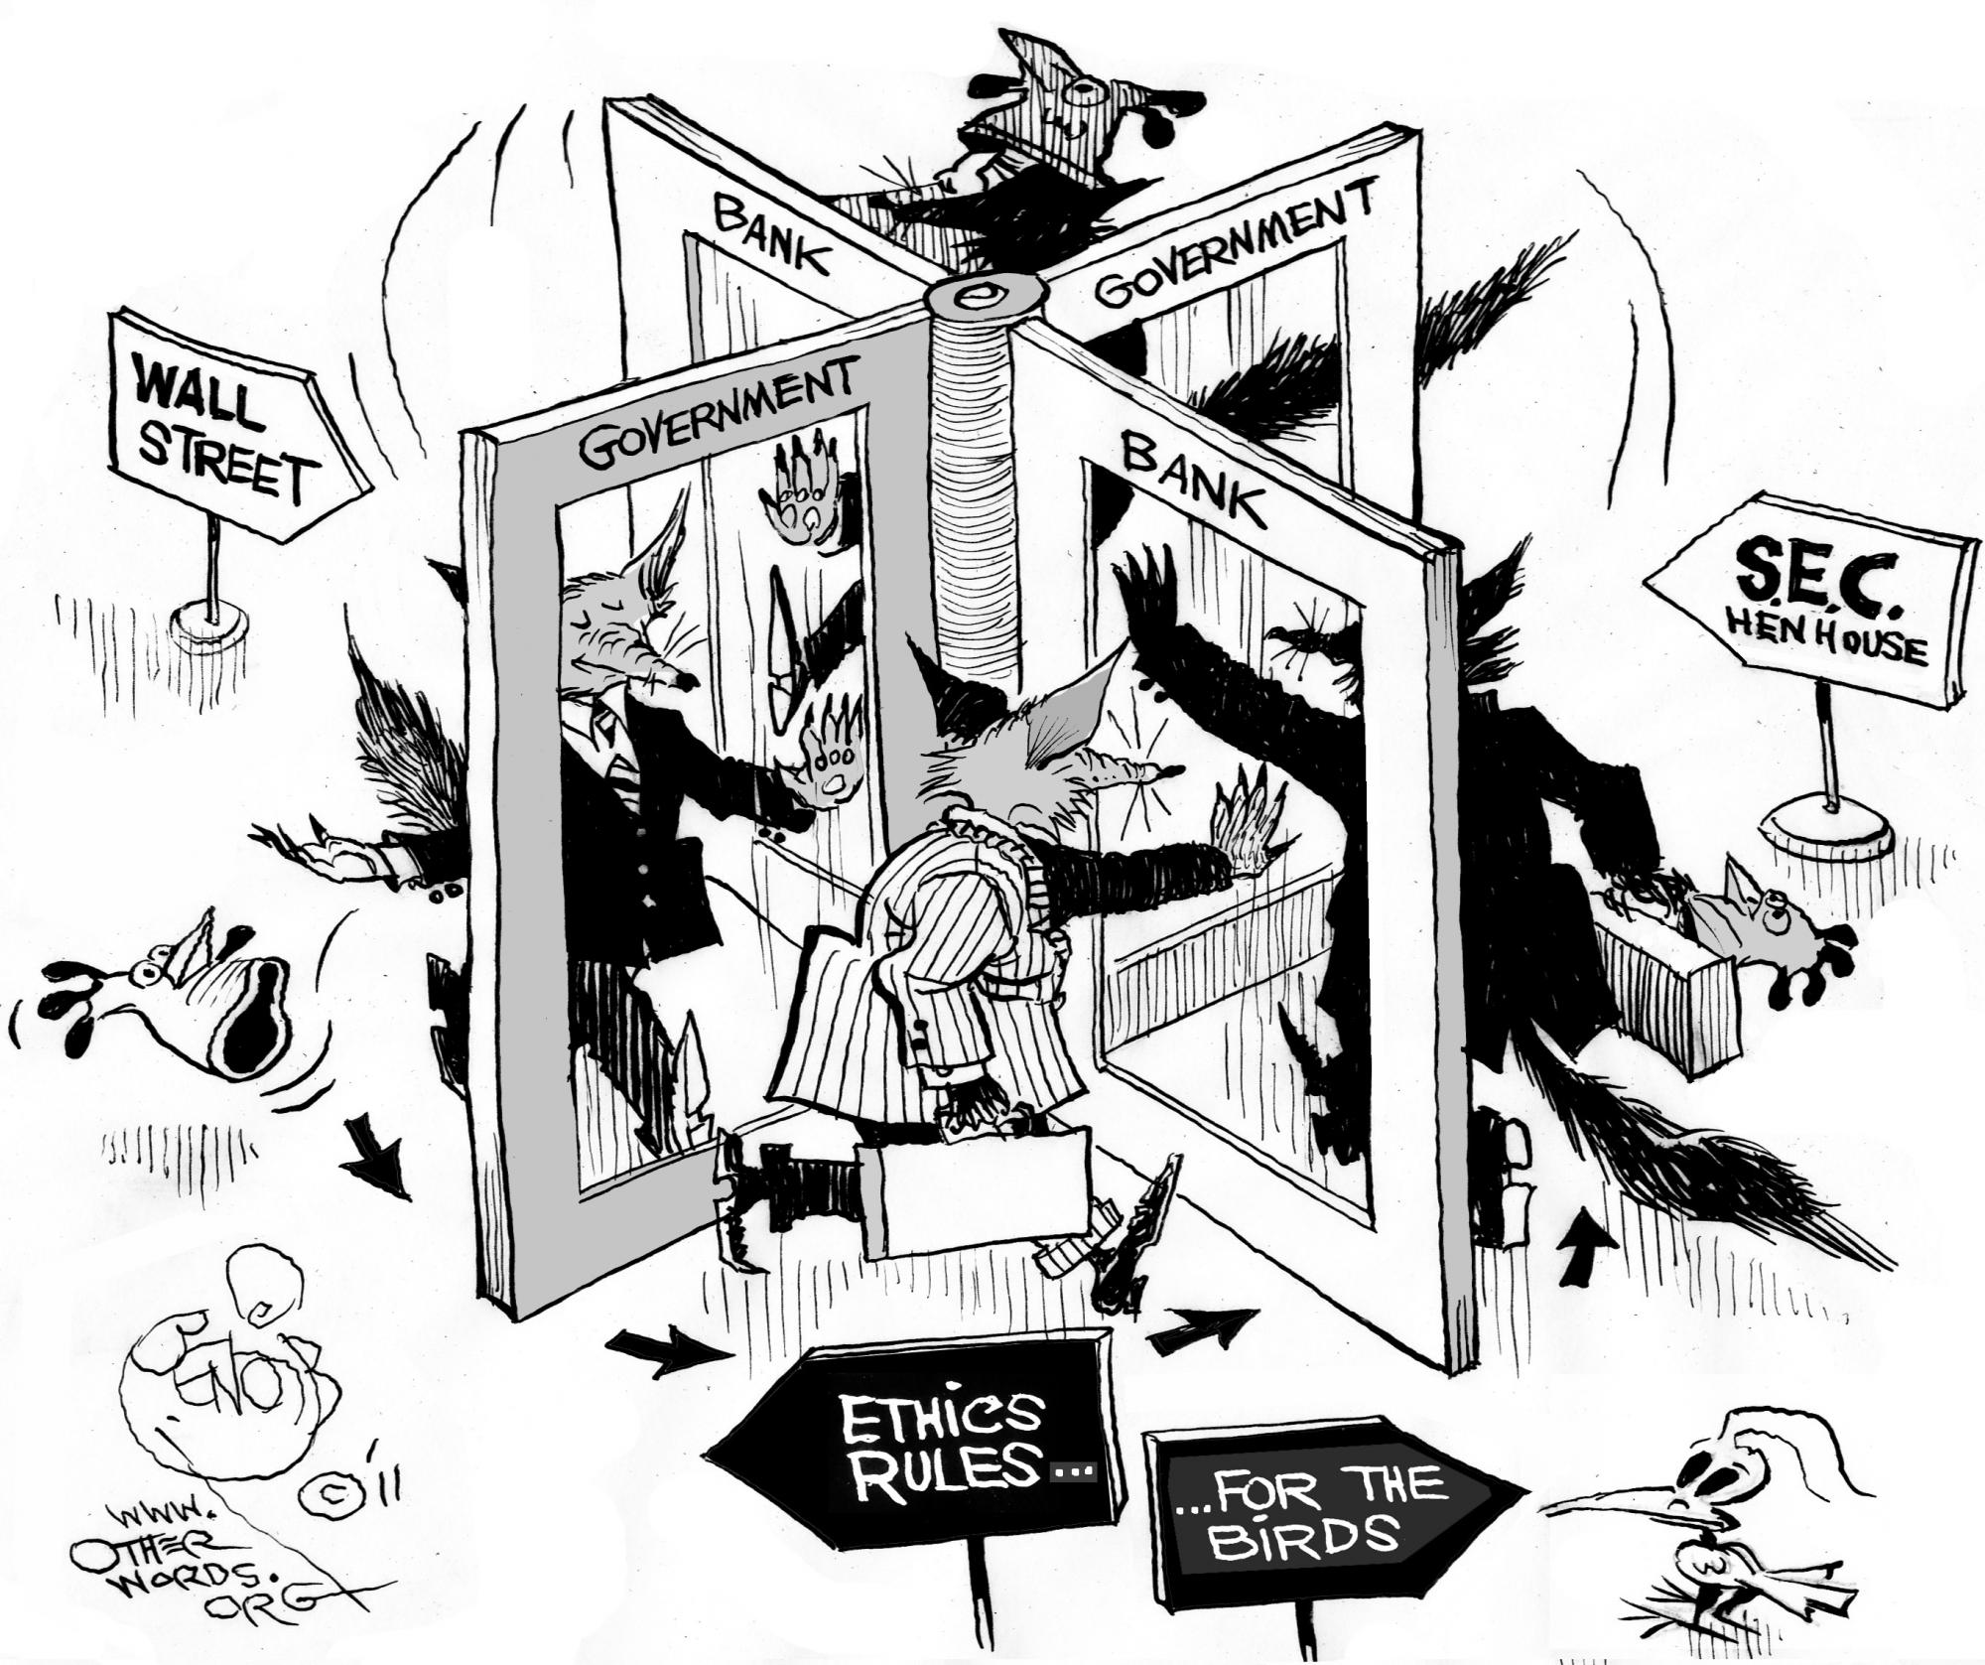
Revolving Door

Slide 20
Revolving Door: 1103(g)
No former public official or public employee shall
1
2
3
4
Represent a *person*
For promised or actual compensation
Before their former governmental body
For one year after leaving. (Executive Level is two years).

Slide 21

SIMILO Order 1717
1103(g) when:
Former Board Member contracted with Authority for consulting services and selling manhole covers to Authority within a year of leaving the Board..

Slide 22

STATEMENTS OF FINANCIAL INTERSTS

Slide 23


Slide 24
Blocks 1 and 2: Name and Address
Enter your last name, first name, middle initial and suffix (if applicable)
Use your exact name as used in your official capacity
List an office (business or governmental) or home address
Include daytime telephone number

Slide 25

Blocks 3 and 4: Status, Public Position or Public Office
Check the block(s) to indicate your status
If correcting a prior filing, check the block at the end designating an amended filing.
Check the block (seeking, hold, held) for each position you list in blocks A and B, including positions held in the prior calendar year
If additional blocks are needed, attach a blank piece of paper with your name at the top, and list the remaining position(s)
Blocks A and B should include the official job titles (i.e., board member, commissioner).

Slide 26
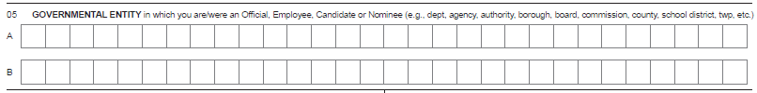
Blocks 5, 6 and 7: Governmental Entity, Occupation/Profession and
Blocks 5, 6 and 7: Governmental Entity, Occupation/Profession and Year
Block 5: List the names of all entities where you hold a position or are seeking to hold
Example: School District Name, Authority Name, Township, Borough, etc.
Block 6: List your “current” occupation or profession.
Block 7: Forms are due May 1st each year. Just like income taxes, you are always filing your form for the prior calendar year (i.e., in 2016, you are filing your form for calendar year 2015

Slide 27
Blocks 8 and 9: Real Estate Interests and Creditors
Block 8: Applies to any real estate leased, purchased or sold to or from the Commonwealth or any other governmental body within the Commonwealth in the prior calendar year.
If NONE, then check the box to the right of “none”.
Block 9: List any creditors where the balance owed was in excess of $6,500 at any time during the prior calendar year, regardless of whether such debt is held solely by you or jointly by you and any other individual (including your spouse) where each obligor is fully responsible for the obligation.
Examples: car loans, school loans, credit cards, personal loans and lines of credit.
DO NOT report a mortgage or equity loan on your home (or secondary home) or loans/credit between you and your spouse, child, parent or sibling.
If this does not apply to you, then check the box to the right of “NONE”.

Slide 28
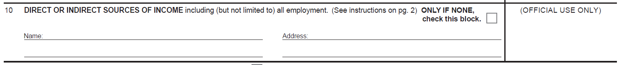
Block 10: Direct or Indirect Sources of Income
Report the name and address of each source of $1,300 or more of gross income, regardless of whether the income is received solely by you or jointly by you and another individual, such as a spouse.
However, spousal income should not be reported.
Examples of data: School District name and address, County name and address where you serve your position, or Board name and address, etc.
If you have “no” reportable sources of income, then check the box by “none”.

Slide 29

Sources of Income
“Income” : includes money or thing of value received or to be received as a claim on future services or in recognition of services rendered in the past, whether in the form of a payment, fee, salary, expense, allowance, forbearance, forgiveness, interest, dividend, royalty, rent, capital gain, reward, severance payment, proceeds for the sale of a financial interest in a corporation, professional corporation, partnership or other entity.

Slide 30
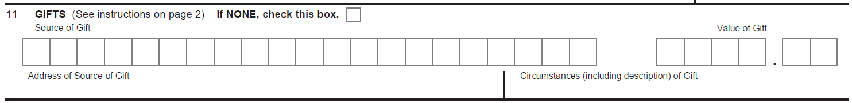
Block 11: Gifts
Block 11: for each gift(s) valued at $250 or more, list the following information: the name and address of the source, the circumstances including a description of each gift and the value of the gift(s).
DO NOT REPORT gift(s) from family members
If you did not receive any reportable gift(s), then check the box to the right of “NONE”.

Slide 31
Block 12: Transportation, Lodging and Hospitality
Block 12: List the name and address of each source and the amount of each payment/reimbursement by the source for transportation, lodging or hospitality that you received in connection with your public position if the aggregate amount of such payments/reimbursements by the source exceeds $650 for the calendar year for which you are reporting.
Do not report reimbursements made by your governmental body or by an organization/association of public officials/employees of political subdivisions that you serve in an official capacity.
Examples include: Sporting events, golf, hotel, meals, drinks, movie tickets, spa/resort, conferences
If you do not have any reportable transportation, lodging or hospitality, then check the box to the right of “NONE”.

Slide 32
Blocks 13: Office, Directorship or Employment in any Business
This block focuses solely on your status as an officer, director or employee, even if you receive no compensation for this position.
List the name and address of the business entity (including non-profit business/boards) for any office that you hold (for example, President, Vice President, Secretary, Treasurer) or any directorship that you hold(through service on a governing board such as board of directors), and any employment that you have in any capacity whatsoever, as to any business entity.
If you do not have any reportable Office, Directorship or Employment in any Business, check the box to the right of “NONE”.

Slide 33
Blocks 14 and 15: Financial Interest in any Legal Entity and Business Interests Transferred
Block 14: List the name and address and interest held in any business for profit of which you own more than 5% of the equity or assets.
If you do not have any such financial interest to report, then check the box to the right of “NONE.”
List the name and address of any business which you transferred a financial interest (as defined in item 14) to a member of your immediate family, as well as the interest held, relationship to the individual and date of transfer.
If you did not transfer any such business interest, then check “NONE”.

Slide 34
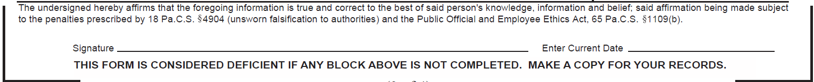

Signature and Date Block
Signature block: Sign the form and enter the current date.
IMPORTANT: Do not back date the form. Better late than never..

Slide 35
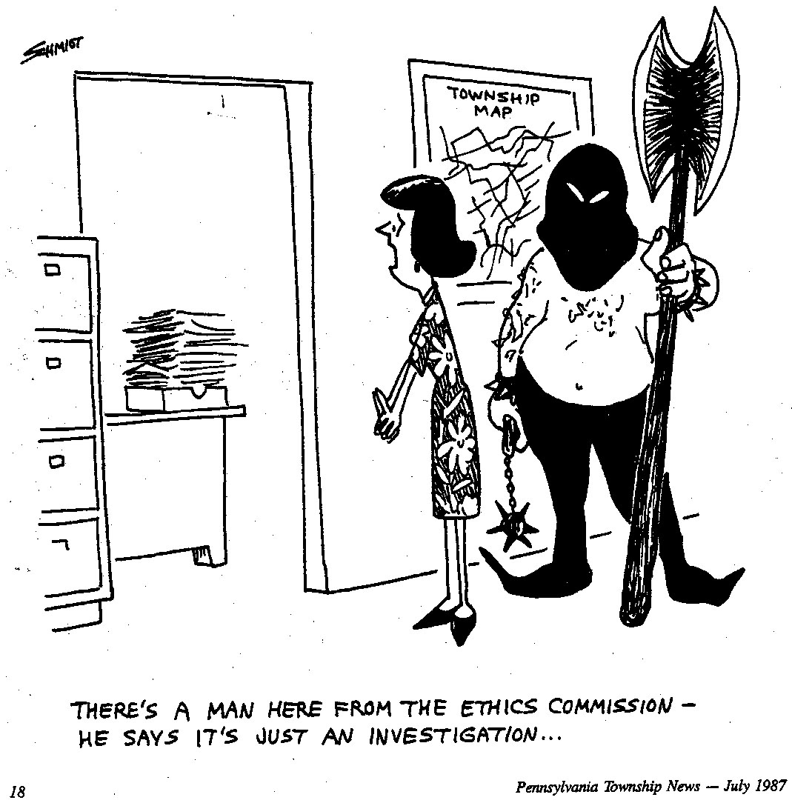
Investigations
Proceedings and records relating to an investigation are confidential
Identity of a complainant is confidential
Final Order is a public record

Slide 36

Penalties
Administrative and Civil:
- Violation of Act (Public Order)
- Restitution
- Treble Penalty (Restitution + Penalty)
- Statements of Financial Interests $25/$250
Criminal:
Any person who violates the provisions of section 1103(a), (b) and (c) (relating to restricted activities) commits a felony and shall, upon conviction, be sentenced to pay a fine of not more than $10,000 or to imprisonment for not more than five years, or both. 65 Pa.C.S.§1109 (a).
Other violations of the Ethics Act punishable by a fine of not more than $1,000 or to imprisonment for not more than one year, or both.

Slide 37
Response to Enforcement Petition
$250.00 Civil Penalty
$371.06 Court Costs
Found in Contempt of Court
Warrant for your Arrest
SFI Shown to Whole State
PRICELESS

Slide 38

THANKS!
Do you have any questions?
www.ethics.pa.gov
+717 783 1610
slidesgo

