Slide 1

The American Rescue Plan
City of Bethlehem

Slide 2
American Rescue Plan Act of 2021
On March 10th, 2021, the U.S. House of Representatives passed the Senate-amended H.R. 1319, the American Rescue Plan (ARP). The ARP provides
$1.9 trillion in additional relief to respond to the novel coronavirus (COVID-19). This follows the enactment of nearly $4 trillion in COVID relief in 2020.
ARP includes provisions on aid to state and local governments, hard-hit industries and communities, tax changes affecting individuals and business, and other provisions. The latest COVID relief legislation includes provisions impacting a wide variety of stakeholders.

Slide 3
Key Provisions:
Rental Housing and Assistance
Individuals and Families
Small Businesses
Healthcare
Education
Transportation
State and Local Governments

Slide 4
Key Provisions:
Rental Housing and Assistance
Individuals and Families
Small Businesses
Healthcare
Education
Transportation
State and Local Governments
$21.6 billion will be provided for rental assistance payments
$10 billion to establish a Homeowner Assistance Fund to prevent mortgage defaults, foreclosures, and displacements
$10 billion for emergency housing/homelessness support services
$4.5 billion for the Low Income Energy Assistance Program
$500 million to assist low-income households with drinking water

Slide 5
Key Provisions:
Rental Housing and Assistance
Individuals and Families
Small Businesses
Healthcare
Education
Transportation
State and Local Governments
Another round of stimulus checks
$1,400 individual (earning up to $75,000)
$2,800 joint filers (earning up to $150,000)
$1,400 per dependent
Enhanced federal supplemental unemployment benefits of $300 per week
Child credit expanded to $3,000 from $2,000, and to $3,600 for children under six years old
Earned Income Tax Credit expanded for taxpayers without children for 2021

Slide 6
Key Provisions:
Rental Housing and Assistance
Individuals and Families
Small Businesses
Healthcare
Education
Transportation
State and Local Governments
Another round of stimulus checks
$1,400 individual (earning up to $75,000)
$2,800 joint filers (earning up to $150,000)
$1,400 per dependent
Enhanced federal supplemental unemployment benefits of $300 per week
Child credit expanded to $3,000 from $2,000, and to $3,600 for children under six years old
Earned Income Tax Credit expanded for taxpayers without children for 2021

Slide 7
Key Provisions:
Rental Housing and Assistance
Individuals and Families
Small Businesses
Healthcare
Education
Transportation
State and Local Governments
Another round of stimulus checks
$1,400 individual (earning up to $75,000)
$2,800 joint filers (earning up to $150,000)
$1,400 per dependent
Enhanced federal supplemental unemployment benefits of $300 per week
Child credit expanded to $3,000 from $2,000, and to $3,600 for children under six years old
Earned Income Tax Credit expanded for taxpayers without children for 2021

Slide 8
Key Provisions:
Rental Housing and Assistance
Individuals and Families
Small Businesses
Healthcare
Education
Transportation
State and Local Governments
Another round of stimulus checks
$1,400 individual (earning up to $75,000)
$2,800 joint filers (earning up to $150,000)
$1,400 per dependent
Enhanced federal supplemental unemployment benefits of $300 per week
Child credit expanded to $3,000 from $2,000, and to $3,600 for children under six years old
Earned Income Tax Credit expanded for taxpayers without children for 2021
As an advance on the credit, In July families began to receive up to $300 per month for each child under 6 and up to $250 per month for each child age 6 to 17. Roughly 39 million households, or 88% of children in the U.S. are receiving monthly payments. Similar to the stimulus checks, the money is phased out for incomes of $75,000 for individuals and $150,000 for joint filers.

Slide 9
Key Provisions:
Rental Housing and Assistance
Individuals and Families
Small Businesses
Healthcare
Education
Transportation
State and Local Governments
$7.35 billion in additional funding for the Paycheck Protection Program (PPP) – a total of $813.7 billion since its establishment last year
$10 billion for the State Small Business Credit Initiative, which provides funding for state-run small business financing programs
$15 billion for the Economic Injury Disaster Loan program
$28.6 billion to the SBA to administer the Restaurant Revitalization Fund

Slide 10
Key Provisions:
Rental Housing and Assistance
Individuals and Families
Small Businesses
Healthcare
Education
Transportation
State and Local Governments
$7.35 billion in additional funding for the Paycheck Protection Program (PPP) – a total of $813.7 billion since its establishment last year
$10 billion for the State Small Business Credit Initiative, which provides funding for state-run small business financing programs
$15 billion for the Economic Injury Disaster Loan program
$28.6 billion to the SBA to administer the Restaurant Revitalization Fund

Slide 11
Key Provisions:
Rental Housing and Assistance
Individuals and Families
Small Businesses
Healthcare
Education
Transportation
State and Local Governments
$7.35 billion in additional funding for the Paycheck Protection Program (PPP) – a total of $813.7 billion since its establishment last year
$10 billion for the State Small Business Credit Initiative, which provides funding for state-run small business financing programs
$15 billion for the Economic Injury Disaster Loan program
$28.6 billion to the SBA to administer the Restaurant Revitalization Fund
The RRF provides restaurants with funding equal to their pandemic-related revenue loss up to $5 million per physical location, $10 million per business. Recipients are not required to repay the funding as long as funds are used for eligible uses no later than March 11, 2023.

Slide 12
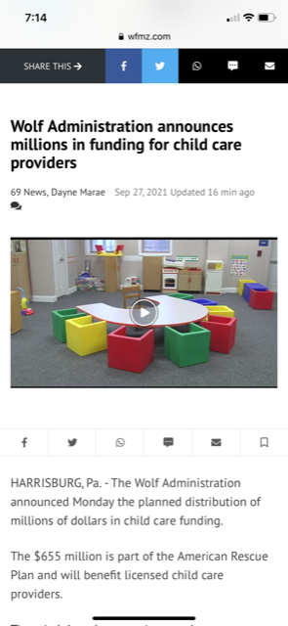
Key Provisions:
Rental Housing and Assistance
Individuals and Families
Small Businesses
Healthcare
Education
Transportation
State and Local Governments
COBRA coverage for individuals who are laid off
ACA marketplace subsidies
Medicaid expansion
Medicaid & CHIP COVID-19 coverage
Medicaid drug rebates
Health and Human Service (HHS) funding:
$47.8 billion for testing, tracing, and a national strategy
$24 billion for child care providers
$8.5 billion for vaccine activities at CDC
$7.66 billion to expand the public health workforce
$7.6 billion for testing and tracing at community health centers
$6 billion to support manufacturing and purchasing vaccines
$3 billion for Substance Abuse and Mental Health Services

Slide 13
Key Provisions:
Rental Housing and Assistance
Individuals and Families
Small Businesses
Healthcare
Education
Transportation
State and Local Governments
$125.8 billion to support statewide and local funding for elementary
and secondary schools and public postsecondary institutions
$39.6 billion for institutions of higher education
$7.17 billion for the Emergency Connectivity Fund

Slide 14
Key Provisions:
Rental Housing and Assistance
Individuals and Families
Small Businesses
Healthcare
Education
Transportation
State and Local Governments
$30.5 billion to FTA to provide grants to transit agencies
$1.7 billion for rail funding
$8 billion in relief for airports
$3 billion for aviation manufacturers jobs protection
$15 billion for airline payroll support program

Slide 15
Key Provisions:
Rental Housing and Assistance
Individuals and Families
Small Businesses
Healthcare
Education
Transportation
State and Local Governments
$350 billion to state and local governments
$195 billion for states
$25 billion for tribal governments and territories
$130 billion for local governments ($65 billion to counties/$65 billion to cities)

Slide 16
Key Provisions:
Rental Housing and Assistance
Individuals and Families
Small Businesses
Healthcare
Education
Transportation
State and Local Governments
$350 billion to state and local governments
$195 billion for states
$25 billion for tribal governments and territories
$130 billion for local governments ($65 billion to counties/$65 billion to cities)
Lehigh County $71.7 million
Northampton County $61.2 million
City of Bethlehem $34.4 million

Slide 17

Thursday, March 25, 2021
9am – 10am
Northampton County
Virtual Town Hall Meeting
American Rescue Plan Act of 2021
Join us for a Zoom call to provide information and updates regarding funding and eligible expenses
https://zoom.us/j/95343166041?pwd=Umc5Q2RHR0hDQ2l6b0FlN3BMcHoxZz09
SPEAKERS:
Lamont McClure, Northampton County Executive
Hon. Bob Casey, Jr., U.S. Senator
Hon. Susan Wild, U.S. Representative - 7th Congressional District
Hon. Mario Scavello, PA Senator - Senate District 40
Hon. Lisa Boscola, PA Senator - Senate District 18
Fadia Halma, Regional Director - PA DCED

Slide 18





6-Cities Coalition

Slide 19

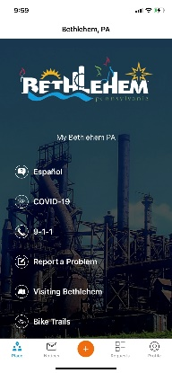



Action Items
Provide information to assist our residents with the funding opportunities that exist within the American Rescue Plan
Communicate with the Counties to coordinate funding opportunities
Develop and propose a comprehensive strategic plan for the City’s allocation
website
app
social media

Slide 20
Lehigh County
Specific details have not been made public.
From WFMZ: “The plan includes funding for the Cedarbrook senior care facility, old courthouse upgrades, HVAC facility system upgrades, jail, nonprofit, small business, human services, IT and community development support, along with money being allocated to a hybrid health bureau study”

Slide 21
Northampton County
Northampton County has announced funding proposals for $30 million, which represents the first half of their allocation:
$15 million to small businesses
$5 million to non-profits
$4 million for hospitality, Grow NORCO, broadband, EMS
$6 million to respond to the pandemic

Slide 22


Excerpts from an article published March 17th, 2021 by Mark Funkhouser, a municipal finance expert who has spent decades in government service. As the mayor of Kansas City during the Great Recession, Mark made the tough choices to put his city on the path to fiscal sustainability. That experience, his long tenure as an auditor and his most recent post as the publisher of Governing magazine have made him a trusted and credible advisor to government officials across the country.
HOW NOT TO SCREW UP YOUR GOVERNMENT’S STIMULUS WINDFALL
Avoid using the stimulus to build new assets or launch new programs that will saddle you with new, unfunded operating costs. If you create new long-term operating expenses, you may be in a worse position than if you hadn’t spent the money at all.
The $350 billion heading to state and local governments to backfill revenue deficits and stimulate additional public spending is an incredible opportunity for not only relief but for growth. Localities have wide latitude on their use the money, and the money coming their way is significant. Given this windfall, what should localities do?
For many of us, it’s been a while since we traveled by air. But we all remember the instructions to “secure your own mask first before assisting others.” The same rule applies for local government. First, fix your own emergency before tackling anything else. Replenishing depleted reserves would be responsible, for example, even if it wouldn’t generate the same headlines as a groundbreaking for a new community center or light-rail line. Second, consider investing some of that money to reduce your operating costs. We all know deferred maintenance costs more the longer you put it off. Now is an opportunity to make those long-overdue investments in infrastructure.

Slide 23
GFOA American Rescue Plan Act Guiding Principles
(Government Finance Officers Association)
Care should be taken to avoid creating new programs or add-ons to existing programs that require an ongoing financial commitment even after the funding ends.
Replenishing reserves used to offset revenue declines during the pandemic should be given high priority to rebuild financial flexibility/stability and restore fiscal resiliency.
Use of ARPA funds to cover operating deficits caused by COVID-19 should be considered temporary and additional budget restraint may be necessary to achieve/maintain structural balance in future budgets.
Investment in critical infrastructure is particularly well suited use of ARPA funds because it is a non-recurring expenditure that can be targeted to strategically important long-term assets that provide benefits over many years. However, care should be taken to assess any on-going operating costs that may be associated with the project.

Slide 24


Excerpts from a March 16, 2021 Express-Times article written by Sara Satullo
The Bethlehem Area School District plans to use its estimated $49 million in federal stimulus dollars to accelerate the replacement of six schools’ HVAC systems and to combat COVID-19 related learning loss amongst its students.
The HVAC replacements at Farmersville, Miller Heights, James Buchanan, Calypso and Hanover and Governor Wolf elementary schools have been languishing for years on the district’s capital plan, which calls for the eventual replacement of all of its HVAC systems. Bethlehem’s been tackling an HVAC replacement or two a year to spread out the cost and has weighed taking out a $10 million bond to fund HVAC projects.
Bethlehem is proposing spending roughly $30 million on HVAC upgrades, with the option of adding in the district education center if bids are favorable. That leaves about $15.8 million to address student’s educational needs like remediation, summer programs and instructional supports.

Slide 25
Guidance from the Brookings Institution
April 27, 2021: Local Governments Plan for American Rescue Plan Funds
Stabilize: So many local governments ran massive deficits last year and are considering cuts to critical services, including essential personnel. These dollars can shore up budgets now and prevent further bleeding.
Strategize: Consider long-term needs
Organize: Work to develop comprehensive plans

Slide 26

Stabilize. Strategize. Organize.

Slide 27

Eligible Uses
Through most of 2020 and all of 2021 to date, City staff has responded in numerous ways to this public health crisis. Emergency Management, Health, EMS, Police, Fire, Community Development, and Public Works have all contributed. We are not done. The response will need to continue. City of Bethlehem essential personnel, including public safety, are qualified reimbursable expenditures for responding to the public health emergency with respect to the Coronavirus Disease 2019 (COVID–19).
The pandemic derailed economic activity and caused significant revenue loss. This funding will allow the City to recover revenue loss due to the pandemic.
In addition, this plan will propose a community reinvestment fund that can provide assistance to small businesses, non-profits, and housing initiatives.

Slide 28
Eligible Uses
Through most of 2020 and all of 2021 to date, City staff has responded in numerous ways to this public health crisis. Emergency Management, Health, EMS, Police, Fire, Community Development, and Public Works have all contributed. We are not done. The response will need to continue. City of Bethlehem essential personnel, including public safety, are qualified reimbursable expenditures for responding to the public health emergency with respect to the Coronavirus Disease 2019 (COVID–19).
The pandemic derailed economic activity and caused significant revenue loss. This funding will allow the City to recover revenue loss due to the pandemic.
In addition, this plan will propose a community reinvestment fund that can provide assistance to small businesses, non-profits, and housing initiatives.

Slide 29
RESPOND RECOVER REINVEST

Slide 30
RESPOND RECOVER REINVEST
Totals
COVID Response: Essential Personnel $ 8,000,000
Revenue Recovery: Capital Needs $12,000,000
Road Infrastructure $ 6,000,000
Community Reinvestment Fund $ 8,467,364(+)
$34,467,364

Slide 31
RESPOND RECOVER REINVEST
Totals
COVID Response: Essential Personnel $ 8,000,000
Revenue Recovery: Capital Needs $12,000,000
Road Infrastructure $ 6,000,000
Community Reinvestment Fund $ 8,467,364(+)
$34,467,364

Slide 32

Last fall, we faced a budget deficit. In order to balance our budget, we cut expenses, including personnel.
In addition, we raised property taxes.
The first part of this proposal is focused on making adjustments to our income statement and balance sheet in order to limit and contain those actions for as much as possible as long as possible.

Slide 33
Revenue
Percentage of the 2021 Budget
Act 511 Taxes

Slide 34
Personnel, primarily public safety, is our largest expense
Expenses as a percentage of the 2021 budget

Slide 35
Our 5-Year Model

Slide 36
Our 5-Year Model
7.1%
3.2%
3.9%

Slide 37
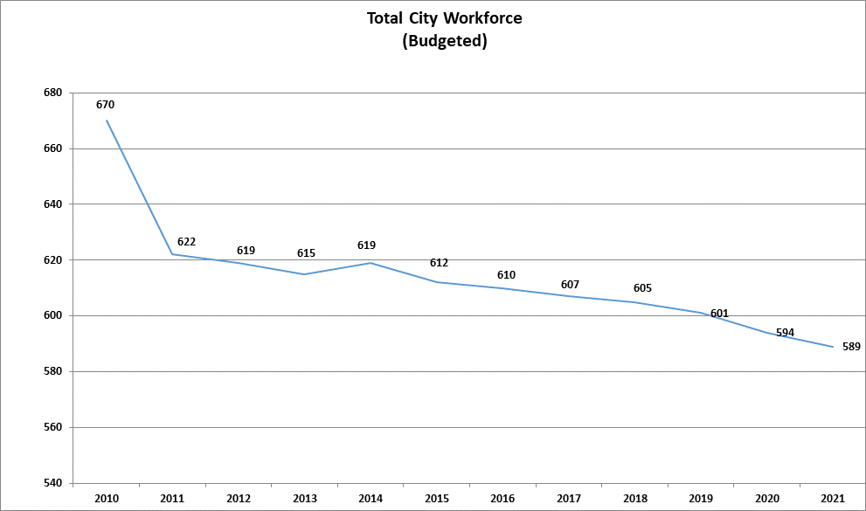

Slide 38
Proposal: Dedicate RESPONSE funding in order to limit/contain:

Slide 39
Proposal: Dedicate RESPONSE funding in order to limit/contain:
Cuts in essential personnel levels

Slide 40
Proposal: Dedicate RESPONSE funding in order to limit/contain:
Cuts in essential personnel levels Property tax increases
7.1%
3.2%
3.9%

Slide 41
RESPOND RECOVER REINVEST
Totals
COVID Response: Essential Personnel $ 8,000,000
Revenue Recovery: Capital Needs $12,000,000
Road Infrastructure $ 6,000,000
Community Reinvestment Fund $ 8,467,364(+)
$34,467,364

Slide 42
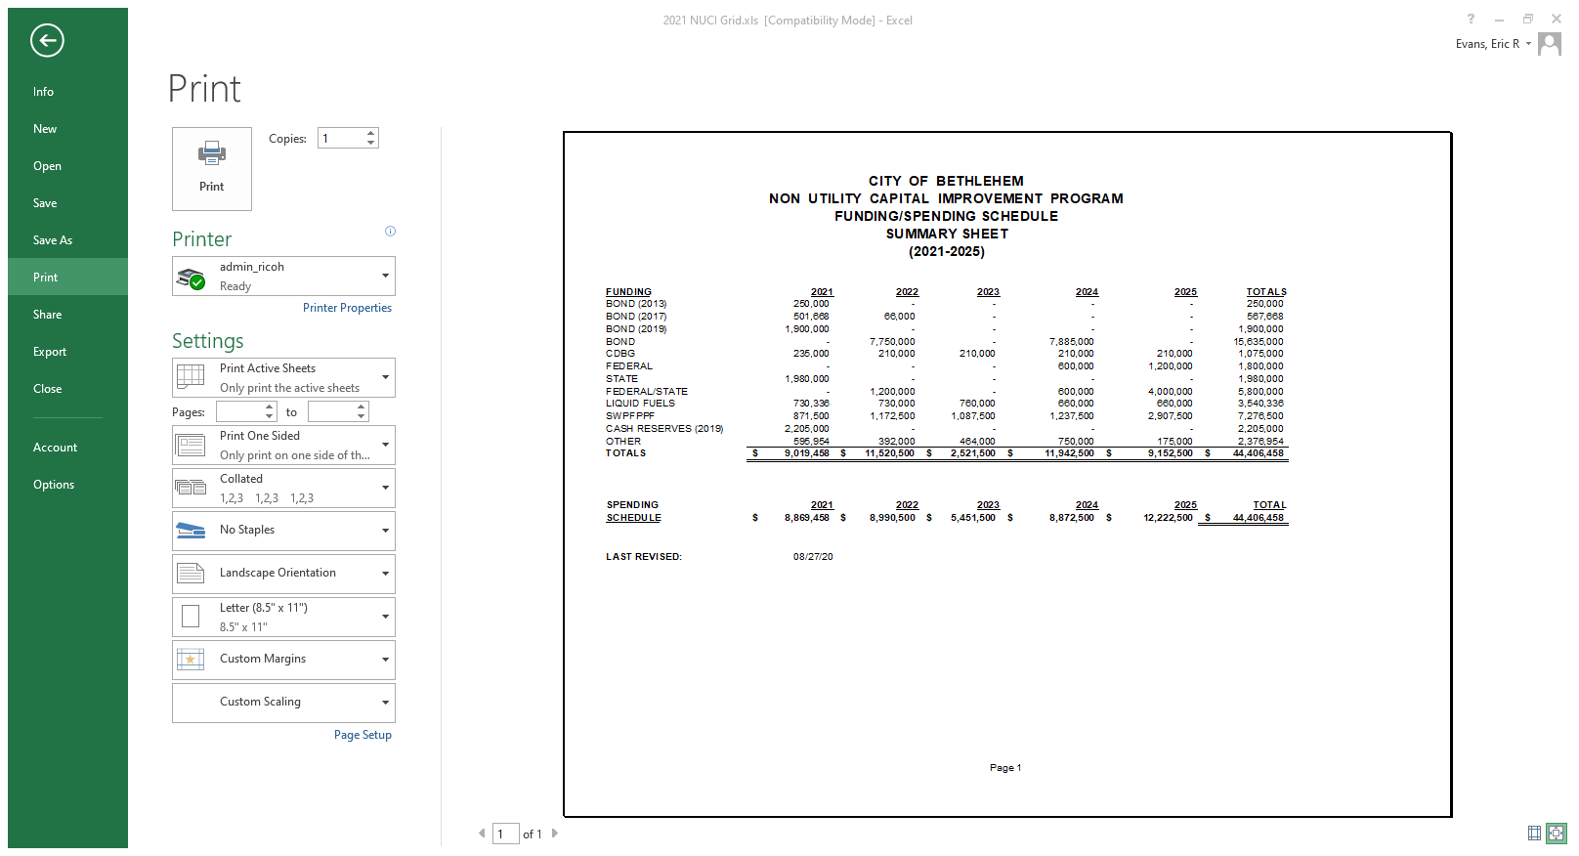
Each year the Administration presents Council with the 5-year Capital Improvement Plan
Last fall it was presented at a Committee of the Whole meeting on October 6, 2020.
The full documents from that meeting can be found at
https://www.Bethlehem-pa.gov/Calendar/Meetings/2020/Committee-Meeting/155?
NON-UTILITY CAPITAL IMPROVEMENT PROGRAM
2021-2025
PROJECT DESCRIPTION
Last revised 8/27/20
I. PUBLIC SAFETY
1. Ambulance Replacement
The plan is to replace ambulances as necessary to maintain a fully operational fleet of eight (8) ambulances, minimizing breakdowns and expenses incurred from heavy usage and high mileage. The plan involves the on-going replacement from bond or other alternate funding sources. The mechanical bureau will determine which ambulance will need to be replaced regardless of age based on warranty information, mechanical maintenance records and visual inspections of the fleet at the time of replacement.
2. Fire Apparatus Replacement Plan – Engine Replacement #1 Engine Replacement – By 2022 three of the fire department’s engines will be 20 years or older. This purchase would be made to upgrade the pump for the northwest fire station on Catasauqua Rd.
3. Fire Apparatus Replacement Plan – Ladder Truck
Ladder Truck – By 2024 the South Bethlehem Ladder Truck will be 16 years old. It takes 13 months for production. It would be estimated that is would go into service in 2025 making it 17 years old, 7 years past the N.F.P.A recommendation of 10 years for a front line fire vehicle. It is recommended that this replacement also contain pumping capacity, the current ladder does not have a pump, to take into consideration the size of the steel property redevelopment.
II. PUBLIC WORKS
A. TRAFFIC
1. TR/Isolated Intersections
Install ne or upgrade existing signals at various locations. Each intersection costs
between $215,000 to $230,000. Proposed potential new signal locations include East
Boulevard & Linden Street, Butztown Road & Easton Avenue, Linden Street & Elmhurst
Avenue, and Third Avenue & Union Boulevard. Needed upgrade locations include
Linden & Goepp Streets, Goepp & Main Streets, New & Market Streets, North & Main
Streets, Center & Church Streets, Center & Market Streets and Walnut & New Streets
etc. Design work for the upgrading of the traffic signals at the intersections of Linden
Street & Elizabeth Avenue and Broad and Linden Streets were completed in 2019 and
construction will be in late 2020. Design for the intersections of Linden & Goepp Streets
and Goepp & Main Streets will begin in 2021, with construction to follow in 2022
depending on funding.

Slide 43
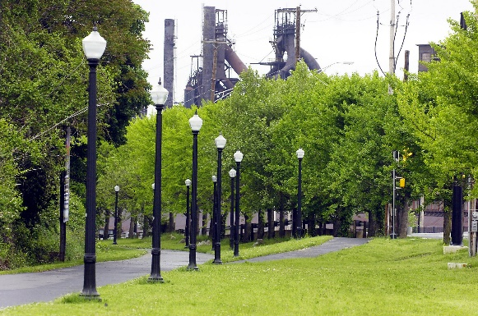
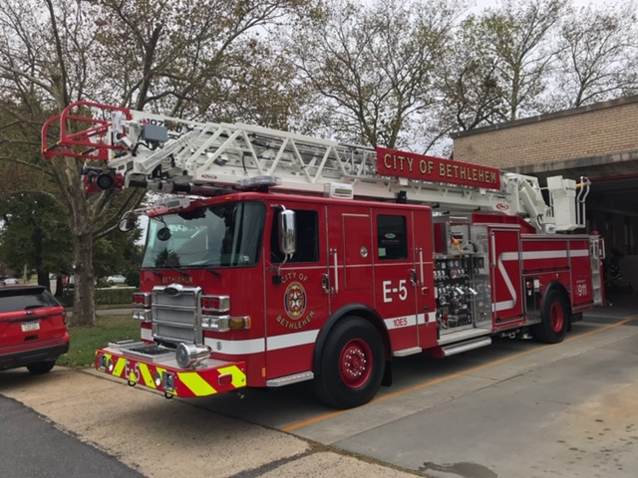
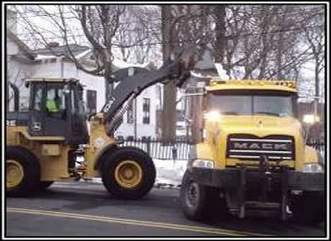
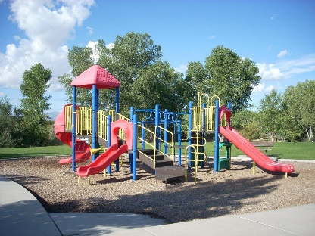
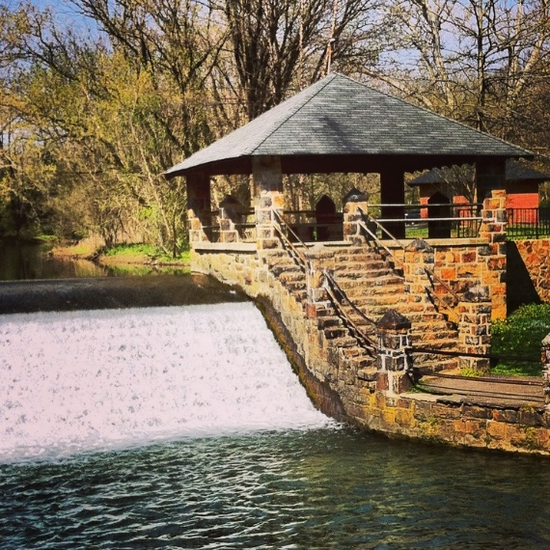
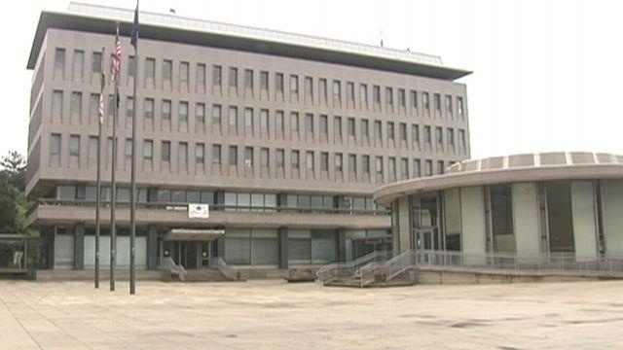
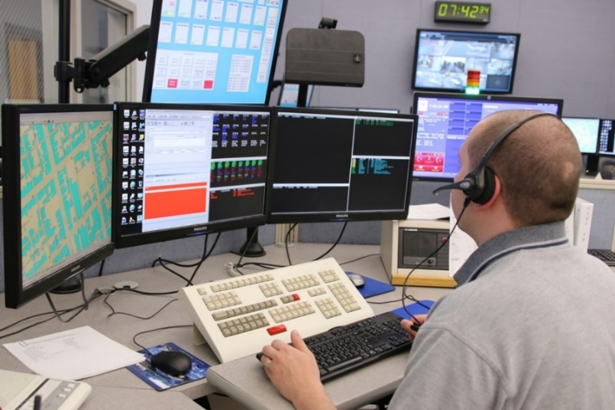
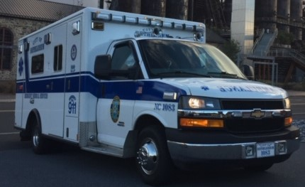

Slide 44
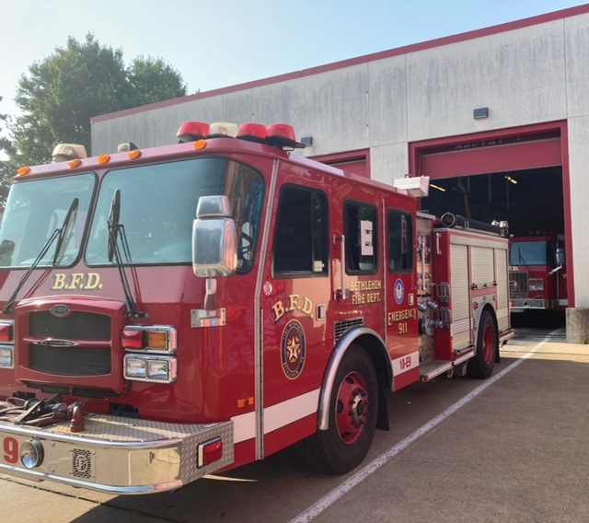
Replacement for Engine-9
(located at the Northwest Fire House on Catasauqua Road)

Slide 45
North West Fire Station
Catasauqua Road
2019
Lincoln Fire Station
Easton Avenue
Haz Mat E-9
2002
Reserve
1998
Under 10 years old 5
11-16 years old 0
17+ years old 6
E-7 E-5
2000 1998
Memorial Fire Station
West Broad Street
E-6 A-2 (100’)
2009 2016
Reserve
1998
Schweder Fire Station
4th Street
E-1 A-1 (100’)
2013 2009
E-3
2000

Slide 46
North West Fire Station
Catasauqua Road
Lincoln Fire Station
Easton Avenue
Haz Mat E-9
2002
Reserve
1998
E-7 E-5
2000 1998
ARP
2022
Planned
for 2024
Memorial Fire Station
West Broad Street
Bond
2019
E-6 A-2 (100’)
2009 2016
Reserve
1998
Cash
2020
Schweder Fire Station
4th Street
E-1 A-1 (100’)
2013 2009
E-3
2000
CARES
2021

Slide 47
North West Fire Station
Catasauqua Road
2024
Lincoln Fire Station
Easton Avenue
Haz Mat E-9
2022
Reserve
2002
Under 10 years old 7
11-16 years old 3
17+ years old 1
E-7 E-5
2024 2019
Memorial Fire Station
West Broad Street
E-6 A-2 (100’)
2020 2016
Reserve
2009
Schweder Fire Station
4th Street
E-1 A-1 (100’)
2013 2009
E-3
2021

Slide 48
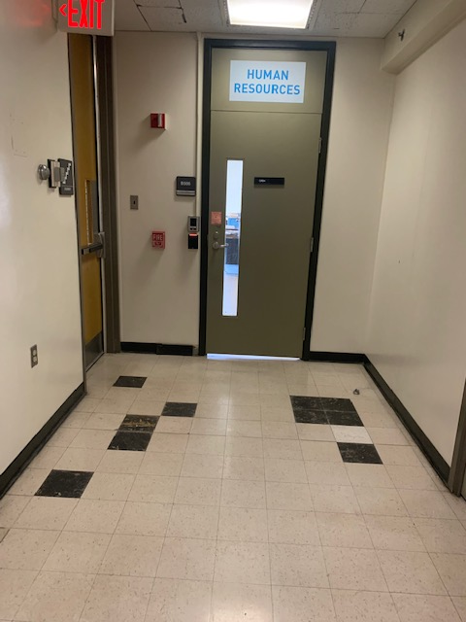
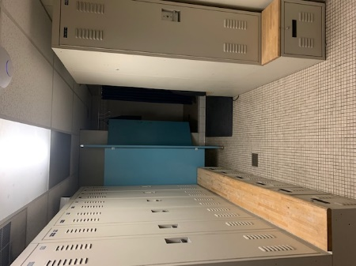
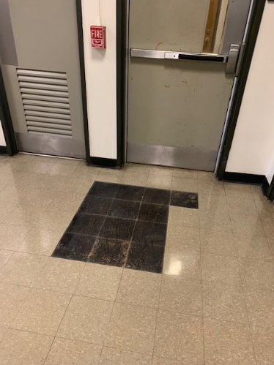
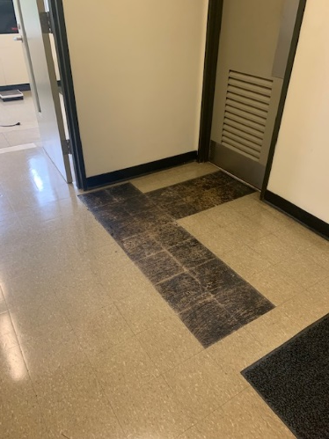
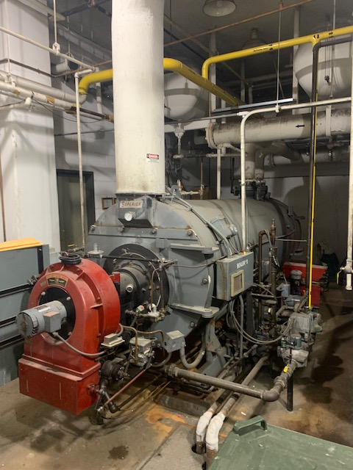
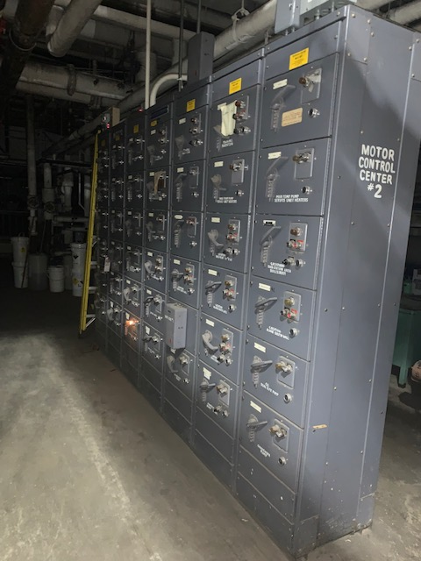
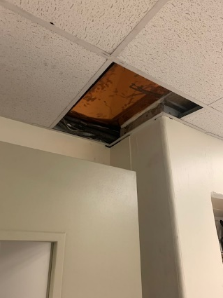
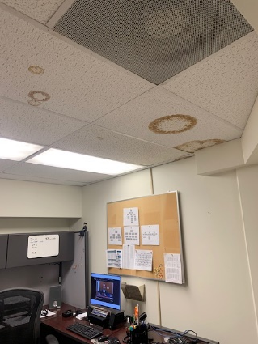
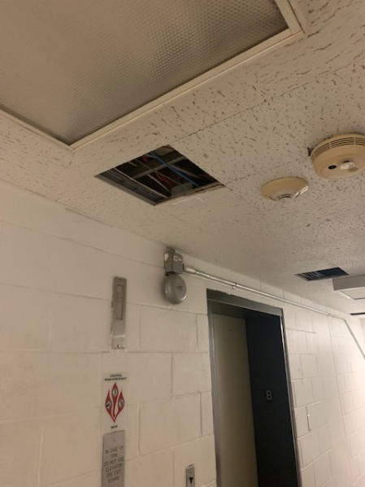
Conditions of City Facilities
Outdated police locker rooms
Flooring
Ceiling tiles, leaking pipes, water damage
Heating and cooling systems

Slide 51

Traditional:
Issue a $5 million bond: 2022, 2024, 2026, etc.

Slide 52

Our concern for debt
Funding proposal
$2,500,000 from Cash to NUCI
$1,480,000 from 9-1-1 to NUCI
ITEMS PROPOSED TO BE FUNDED
Quint Ladder Truck | $ 540,000 | Payment #2 ($600K paid in 2019)
Rescue Engine Replacement | $ 800,000
Trunking System Radios | $ 565,000 | Payment #2 ($650K paid in 2019)
Snow Blower for 624K Loader | $ 175,000
Street Overlays | $ 420,000 | Plus $1.9MM ($1MM Bond, $125K CDBG, $736K Liquid) '19-'20
Chiller Replacement | $ 180,000
Garage Floor Repair | $ 200,000 | $200K was in 2019 Bond, will also need $400K in 2021 Bond
Library Column Repair | $ 200,000 | $200K was in 2019 Bond, will also need $400K in 2021 Bond
Rodgers Street Facility | $ 900,000
 | $ 3,980,000
Pension and Debt Monster
Mayor’s 2019 Budget Address Slide Show
2019 transfer request – investing without debt
“We postponed our borrowing that was planned for 2021. Our 5-year capital plan typically includes a bond borrowing of approximately $5 million in order to complete capital projects and purchases. That borrowing will be postponed until 2022 when the economy is hopefully back on firmer footing.” Mayor’s 2021 Budget Address

Slide 53
This is the Debt Service page from the 2021 budget book. The entire budget can be found at
https://www.bethlehem-pa.gov/getattachment/City-Government/Budget-and-Audits/FINAL-BUDGET-2021.pdf.aspx?lang=en-US
Schedule of Payment of Bond & Note Indebtedness
 |  | Series of 2007 |  |  | Series of 2013 B |  |  | Series of 2014 A |  |  | Series of 2015 A |  |  | Series of 2015 B |  |  | Series of 2017 A |  |  | Series of 2017 B |  |  | Series of 2017 E |  |  | Series of 2019 |  |  | Series of 2019 A |  |  | Series of 2019 AA
 |  | Principal | Interest |  | Principal | Interest |  | Principal | Interest |  | Principal | Interest |  | Principal | Interest |  | Principal | Interest |  | Principal | Interest |  | Principal | Interest |  | Principal | Interest |  | Principal | Interest |  | Principal | Interest |  | Total
2021 |  | 346,000 | 19,165 |  | 680,000 | 198,364 |  | 15,000 | 25,200 |  | 35,000 | 141,963 |  | 345,000 | 32,450 |  | 195,000 | 312,590 |  | 295,000 | 180,139 |  | 2,135,000 | 686,950 |  | 305,000 | 134,996 |  | 2,835,000 | 1,434,069 |  | 280,000 | 114,925 |  | 10,746,811
2022 |  | 356,000 | 9,719 |  | 710,000 | 172,232 |  | 325,000 | 24,900 |  | 35,000 | 141,132 |  | 350,000 | 25,550 |  | 200,000 | 306,740 |  | 310,000 | 168,339 |  | 2,000,000 | 580,200 |  | 315,000 | 125,846 |  | 3,330,000 | 1,377,086 |  | 285,000 | 103,725 |  | 11,251,469
2023 |  |  |  |  | 740,000 | 143,527 |  | 630,000 | 17,588 |  | 35,000 | 140,300 |  | 360,000 | 17,675 |  | 205,000 | 301,740 |  | 320,000 | 155,939 |  | 2,090,000 | 480,200 |  | 325,000 | 116,396 |  | 3,105,000 | 1,307,522 |  | 300,000 | 92,325 |  | 10,883,211
2024 |  |  |  |  | 770,000 | 112,128 |  | 105,000 | 2,625 |  | 825,000 | 139,469 |  | 365,000 | 9,125 |  | 210,000 | 296,359 |  | 335,000 | 143,139 |  | 1,950,000 | 375,700 |  | 335,000 | 106,646 |  | 3,170,000 | 1,239,802 |  | 315,000 | 80,325 |  | 10,885,319
2025 |  |  |  |  | 805,000 | 76,377 |  |  |  |  | 955,000 | 118,844 |  |  |  |  | 220,000 | 290,059 |  | 345,000 | 129,739 |  | 2,430,000 | 278,200 |  | 340,000 | 99,946 |  | 3,245,000 | 1,167,494 |  | 315,000 | 74,025 |  | 10,889,685
2026 |  |  |  |  | 840,000 | 39,001 |  |  |  |  | 1,235,000 | 93,775 |  |  |  |  | 225,000 | 283,459 |  | 360,000 | 115,939 |  | 2,305,000 | 156,700 |  | 345,000 | 93,146 |  | 3,320,000 | 1,090,782 |  | 320,000 | 61,425 |  | 10,884,227
2027 |  |  |  |  |  |  |  |  |  |  | 1,275,000 | 59,813 |  |  |  |  | 230,000 | 277,272 |  | 370,000 | 106,039 |  | 3,230,000 | 104,838 |  | 355,000 | 85,556 |  | 3,405,000 | 1,008,978 |  | 335,000 | 55,025 |  | 10,897,521
2028 |  |  |  |  |  |  |  |  |  |  | 690,000 | 21,563 |  |  |  |  | 1,275,000 | 270,372 |  | 380,000 | 94,939 |  | 1,125,000 | 28,125 |  | 365,000 | 77,569 |  | 4,385,000 | 922,116 |  | 340,000 | 48,325 |  | 10,023,009
2029 |  |  |  |  |  |  |  |  |  |  |  |  |  |  |  |  | 1,960,000 | 232,122 |  | 395,000 | 83,539 |  |  |  |  | 370,000 | 68,900 |  | 5,060,000 | 805,870 |  | 350,000 | 41,100 |  | 9,366,531
2030 |  |  |  |  |  |  |  |  |  |  |  |  |  |  |  |  | 1,885,000 | 171,362 |  | 405,000 | 71,294 |  |  |  |  | 380,000 | 59,650 |  | 5,085,000 | 666,669 |  | 350,000 | 33,663 |  | 9,107,638
2031 |  |  |  |  |  |  |  |  |  |  |  |  |  |  |  |  | 1,940,000 | 112,455 |  | 420,000 | 58,638 |  |  |  |  | 390,000 | 49,200 |  | 5,230,000 | 523,221 |  | 365,000 | 25,788 |  | 9,114,302
2032 |  |  |  |  |  |  |  |  |  |  |  |  |  |  |  |  | 1,550,000 | 50,375 |  | 430,000 | 45,198 |  |  |  |  | 405,000 | 37,500 |  | 4,865,000 | 372,022 |  | 380,000 | 17,575 |  | 8,152,670
2033 |  |  |  |  |  |  |  |  |  |  |  |  |  |  |  |  |  |  |  | 445,000 | 31,223 |  |  |  |  | 415,000 | 25,350 |  | 3,740,000 | 228,942 |  | 380,000 | 9,025 |  | 5,274,540
2034 |  |  |  |  |  |  |  |  |  |  |  |  |  |  |  |  |  |  |  | 460,000 | 15,870 |  |  |  |  | 430,000 | 12,900 |  | 3,850,000 | 117,079 |  |  |  |  | 4,885,849
 |  | 702,000 | 28,884 |  | 4,545,000 | 741,630 |  | 1,075,000 | 70,313 |  | 5,085,000 | 856,859 |  | 1,420,000 | 84,800 |  | 10,095,000 | 2,904,905 |  | 5,270,000 | 1,399,974 |  | 17,265,000 | 2,690,913 |  | 5,075,000 | 1,093,603 |  | 54,625,000 | 12,261,652 |  | 4,315,000 | 757,251 |  | 132,362,782

Slide 54
Current Annual Debt Service

Slide 55
If we continue to borrow for capital needs

Slide 56
Traditional:
Issue a $5 million bond: 2022, 2024, 2026, etc.
Proposed:
Dedicate funding for capital needs: $6 million in 2022 and $6 million in 2024
Invest $12 million in capital needs without taking on additional debt
Push out next capital request to 2027

Slide 57
RESPOND RECOVER REINVEST
Totals
COVID Response: Essential Personnel $ 8,000,000
Revenue Recovery: Capital Needs $12,000,000
Road Infrastructure $ 6,000,000
Community Reinvestment Fund $ 8,467,364(+)
$34,467,364

Slide 58
RESPOND RECOVER REINVEST
Totals
COVID Response: Essential Personnel $ 8,000,000
Revenue Recovery: Capital Needs $12,000,000
Road Infrastructure $ 6,000,000
Community Reinvestment Fund $ 8,467,364(+)
$34,467,364

Slide 59
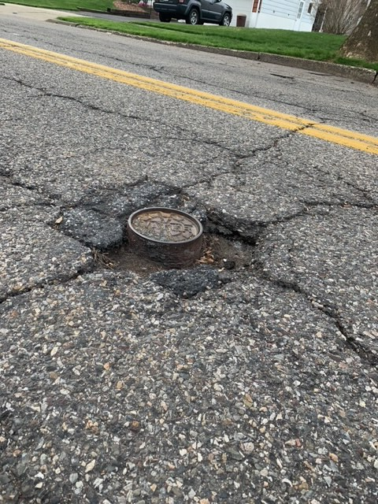
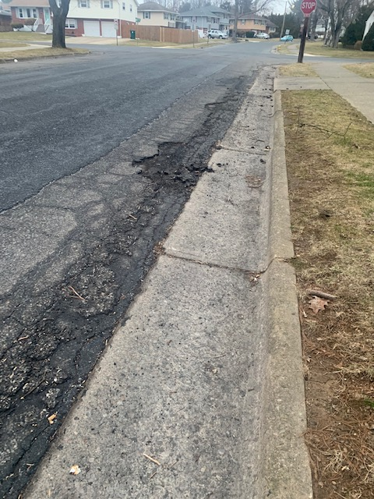
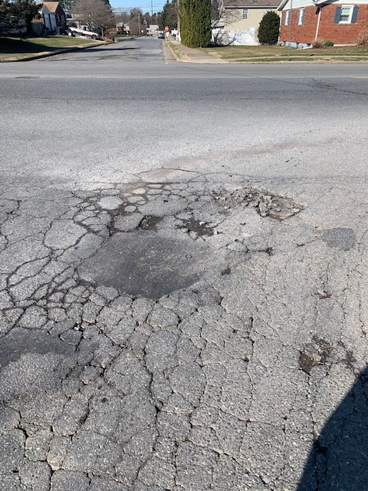
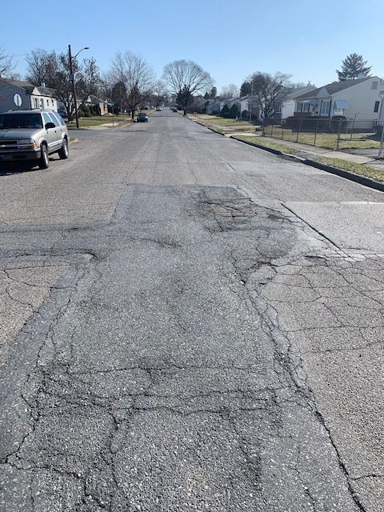
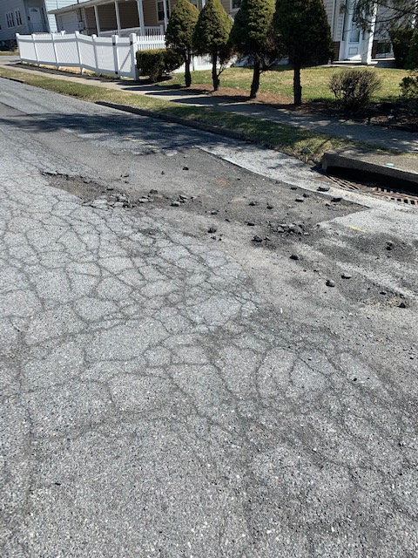
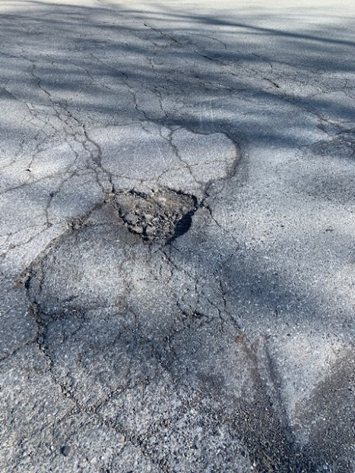
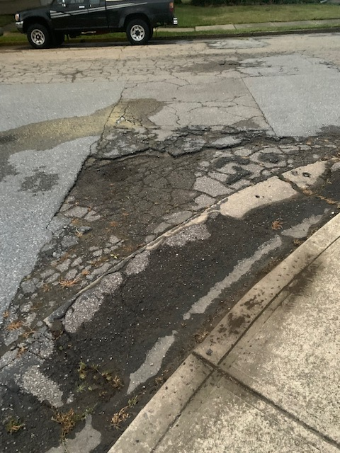
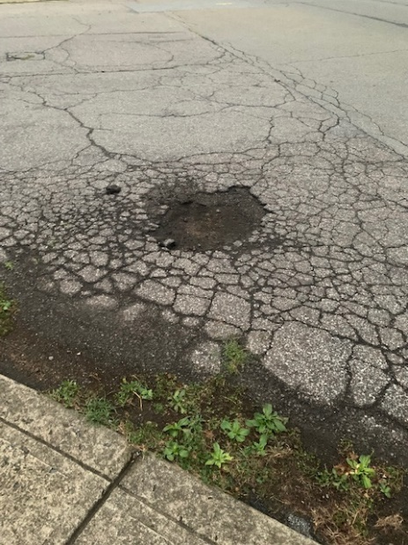
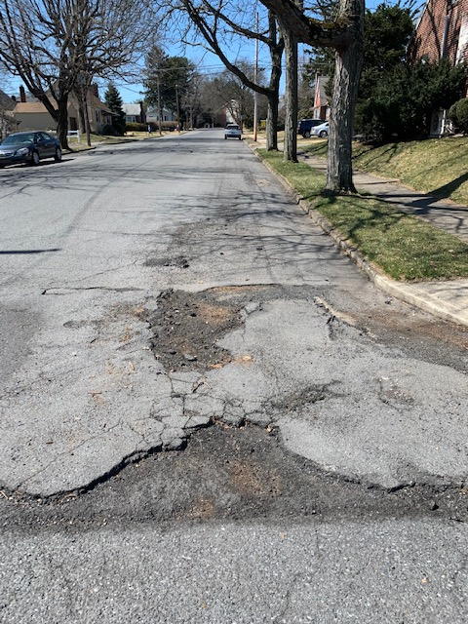
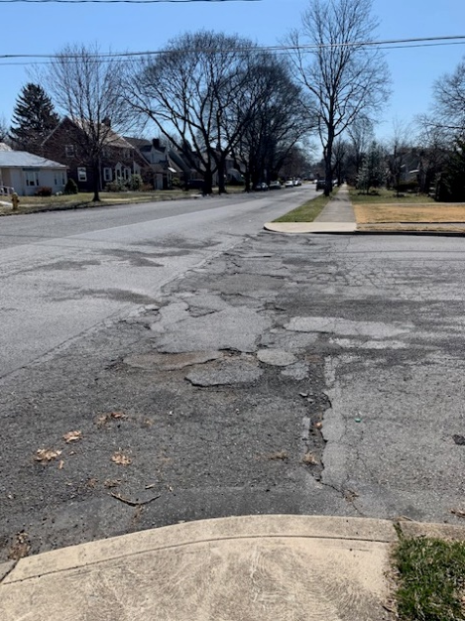
An opportunity to reinvest in our road infrastructure

Slide 60
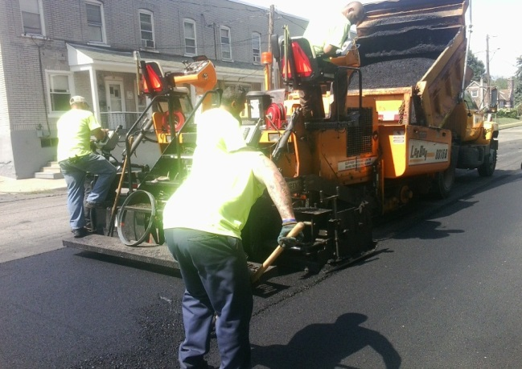
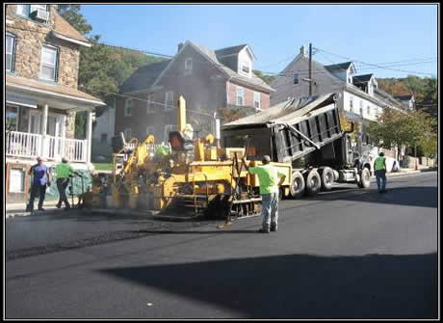
Traditional:
Request $1-$1.5 million from the bond issuance: 2022, 2024, 2026, etc.
Proposed:
Dedicate funding for road infrastructure: $3 million in 2022 and $3 million in 2024
Invest $6 million (2022-2026) versus $3 million under traditional format – without debt

Slide 61
RESPOND RECOVER REINVEST
Totals
COVID Response: Essential Personnel $ 8,000,000
Revenue Recovery: Capital Needs $12,000,000
Road Infrastructure $ 6,000,000
Community Reinvestment Fund $ 8,467,364(+)
$34,467,364

Slide 62
If Bethlehem were to borrow $18,000,000:
Annual debt service added to the General Fund $1,500,000
Interest paid over the 15 year term $4,700,000
Total pf payments over 15 years $22,700,000

Slide 63
Current Annual Debt Service

Slide 64
…..The alternative

Slide 65
RESPOND RECOVER REINVEST
Totals
COVID Response: Essential Personnel $ 8,000,000
Revenue Recovery: Capital Needs $12,000,000
Road Infrastructure $ 6,000,000
Community Reinvestment Fund $ 8,467,364(+)
$34,467,364

Slide 66

$8,467,364(+) for a Community Reinvestment Fund

Slide 67

Key Provisions:
Rental Housing and Assistance
Individuals and Families
Small Businesses
Healthcare
Education
Transportation
State and Local Governments
$7.35 billion in additional funding for the Paycheck Protection Program (PPP) – a total of $813.7 billion since its establishment last year
$10 billion for the State Small Business Credit Initiative, which provides funding for state-run small business financing programs
$15 billion for the Economic Injury Disaster Loan program
$28.6 billion to the SBA to administer the Restaurant Revitalization Fund

Slide 68
Northampton County
Northampton County has announced funding proposals for $30 million, which represents the first half of their allocation:
$15 million to small businesses
$5 million to non-profits
$4 million for hospitality, Grow NORCO, broadband, EMS
$6 million to respond to the pandemic

Slide 69

Affordable Housing/Homelessness

Slide 70
Key Provisions:
Rental Housing and Assistance
Individuals and Families
Small Businesses
Healthcare
Education
Transportation
State and Local Governments
$21.6 billion will be provided for rental assistance payments
$10 billion to establish a Homeowner Assistance Fund to prevent mortgage defaults, foreclosures, and displacements
$10 billion for emergency housing/homelessness support services
$4.5 billion for the Low Income Energy Assistance Program
$500 million to assist low-income households with drinking water

Slide 71

Combining Sources for Affordable Housing/Homelessness
ARP - State and Local Governments
$1,400,000 CARES - HOME ARP
$300,000 CARES - Health

Slide 72
$8,467,364(+) for a Community Reinvestment Fund

Slide 73
Stabilize. Strategize. Organize.

Slide 74
The American Rescue Plan
City of Bethlehem
* Continue to deliver of essential services
* Control taxes
* Maintain critical assets
* Upgrade road system
* Reinvest in community

