Slide 1
City of Bethlehem Stormwater Utility Creation & Fee Implementation
Michael Alkhal, P.E.
Director of Public Works
Matthew Dorner
Deputy Director of Public Works
December 1, 2020

Slide 2
Agenda
Welcome
City of Bethlehem Stormwater
Challenges
Bethlehem’s SW Management Infrastructure
Bethlehem’s Current & Future Costs
Stormwater Utility
Background
Bethlehem User Fee Development
Other Pennsylvania SW Utilities
Timeline
What to expect
Fees
Opportunities to Offset Fees
Questions

Slide 3
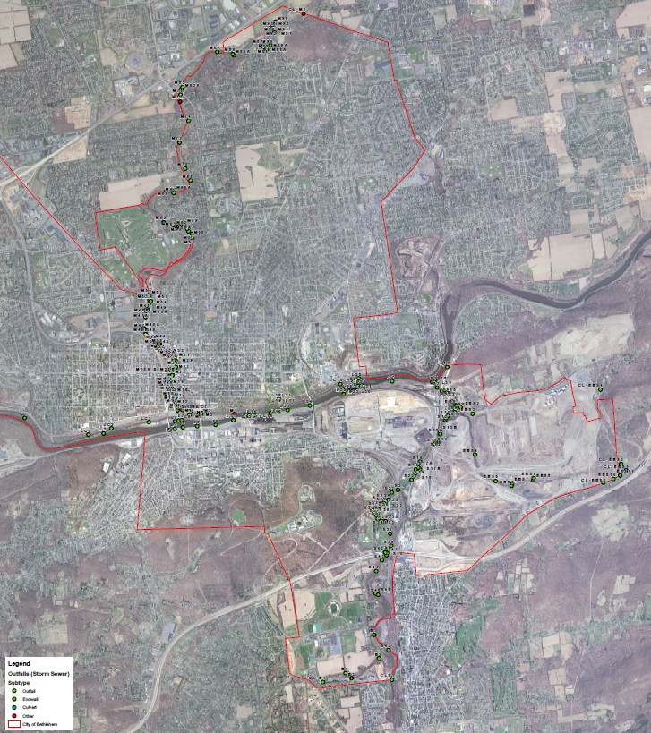
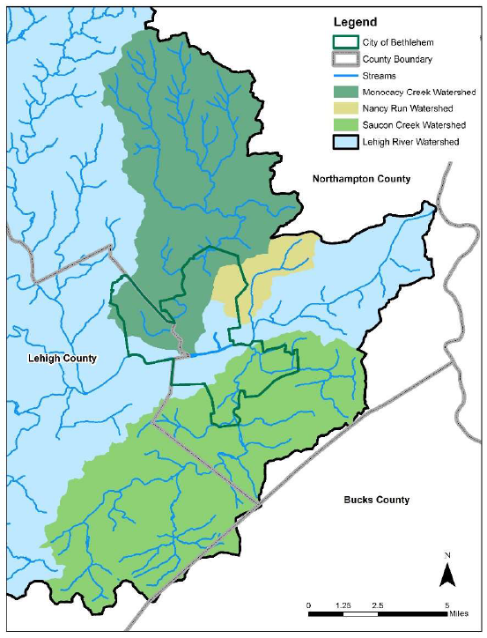
City of Bethlehem Stormwater

Slide 4
City of Bethlehem User Fee – Drivers for Change
Water Quality Permit
Federal Permit – Issued by PADEP
Current Permit issued in 2003
Increased oversight & enforcement by EPA and PADEP
Aging/Deteriorating Infrastructure
Local Flooding Issues
For Small & Large cities
- 2 Large MS4s in PA
(Allentown & Philadelphia)
- 1,059 Small MS4s in PA
Stormwater management is no longer about getting rainfall off property and into the streams as fast as possible.
Important Role for City Services Today:
Storm Sewer Replacement Needs valued at over $12 million.
Protect property from stormwater impacts.
Protect streams by reducing pollutants carried by stormwater.
Reinvest in capital assets to extend life or replace before failures occur.
Additional future Regulatory Requirements are a certainty

Slide 5
Permit Requirements
City’s PADEP National Pollutant Discharge Elimination System (NPDES) Permit # PAI132210
Regulates pollutants discharging through non-point sources to a Water of the U.S
What is MS4?
M – Municipal
S4 – Separate Storm Sewer System
MS4 Program
Requires a Stormwater Program Plan to :
Contain goals for 6 Minimum Control Measures (MCMs)
Contain specific activities to meet goals of each MCM
Implement an MS4 Stormwater Ordinance
Submit Pollutant Reduction Plan (PRP)

Slide 6
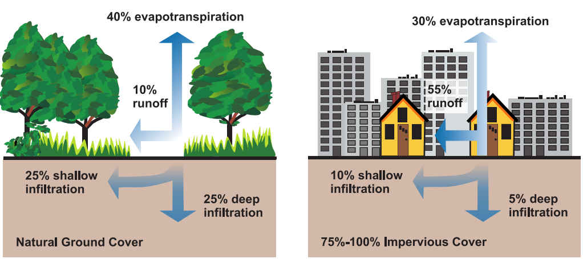
Permit Requirements
MS4 Program
Six Minimum Control Measures
Public Education/Outreach on Stormwater Impacts
Public Involvement/Participation
Illicit Discharge Detection and Elimination
Construction Site Stormwater Runoff Control
Post-Construction Stormwater Management
Pollution Prevention/Good Housekeeping
Compliance and Enforcement on Development and Other Land Uses
Wet Weather Monitoring
Dry Weather Monitoring
Spill Response
Public Education and Outreach
Post-Construction Stormwater Management
System Maintenance
Watershed Protection
Municipal Good Housekeeping
Municipal Training
Industrial Inspections
Total Daily Maximum Load (TMDL) Plans

Slide 7
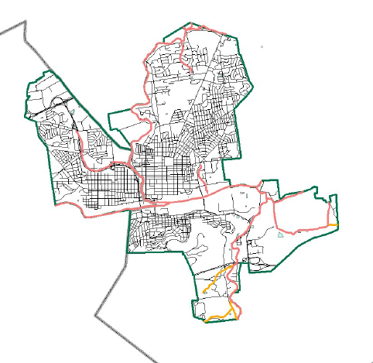
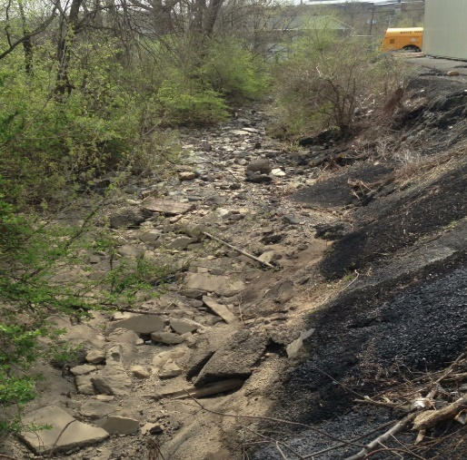
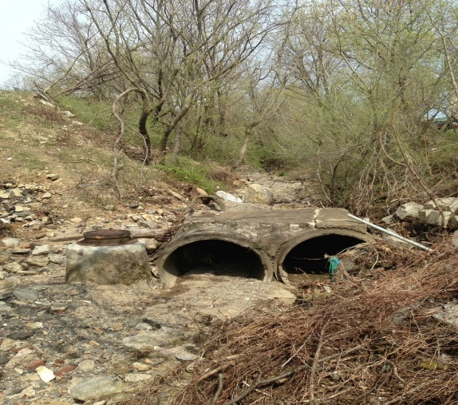
Permit Requirements
Pollutant Reduction Plans (PRP)
Part of MS4 Permit requirement
Development of a Stormwater Management Plan for the City
Reduce Pollutant discharges to Water Quality Impaired Streams
PADEP Requirement:
10% Sediment Reductions
City of Bethlehem PRP New Costs:
BMP # | BMP Description | Total 5 Year Cost
1 | Storm Sewer Systems Solids Removal | $512,000
2 | Street Sweeping | $0
3 | Basin Retrofit – 6 basins | $1,200,000
4 | New BMP Facilities – 5 BMPs | $1,500,000
5 | Streambank Restoration - 360 feet | $324,000
 | TOTAL | $3,536,000
Upcoming PRP Projects:
Stefko Boulevard
Swale Rehabilitation
Stefko Boulevard
Swale Rehabilitation
City of Bethlehem
Impaired Streams

Slide 8
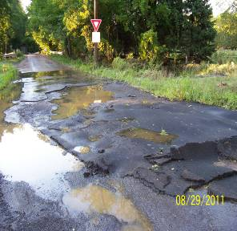
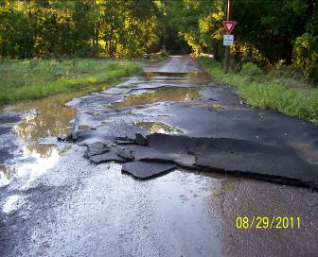
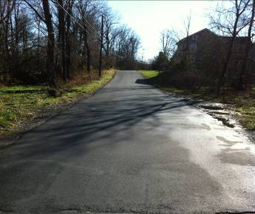
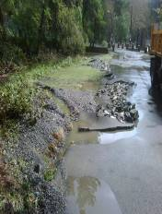
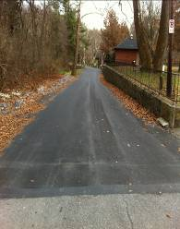
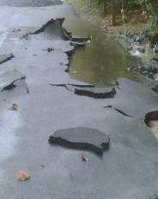
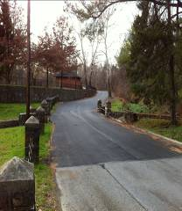
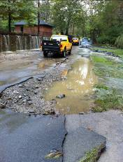
Challenges
Flooding
Creek Road
Monocacy Creek Road

Slide 9
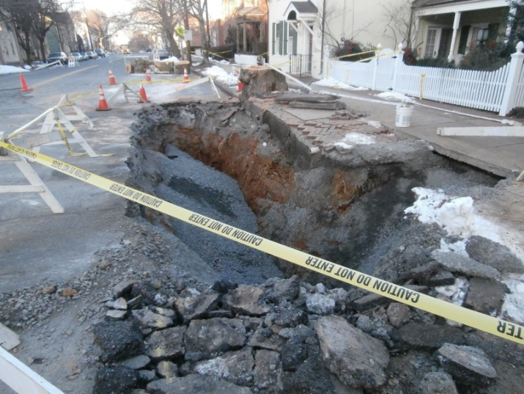
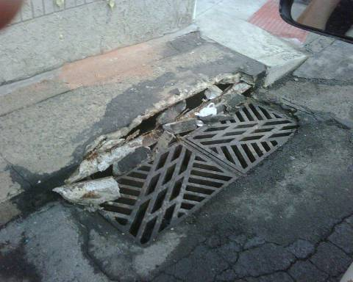
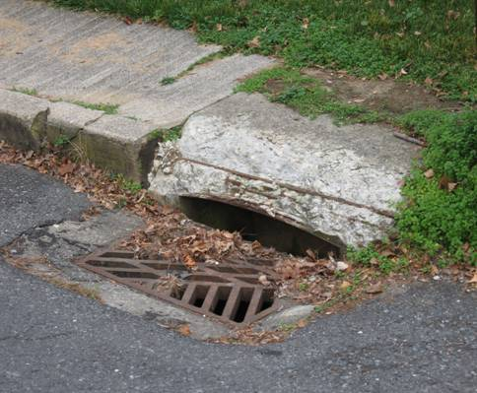
Challenges
Aging Infrastructure

Slide 10
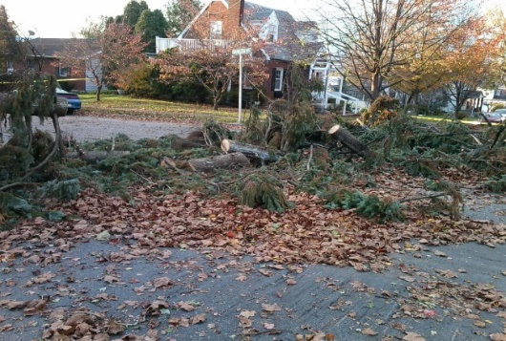
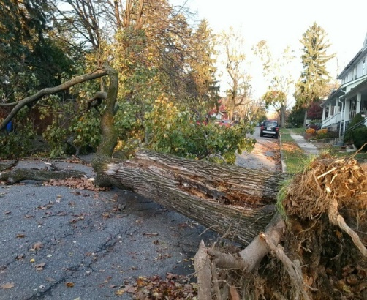
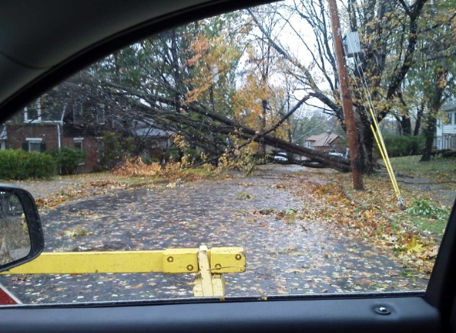
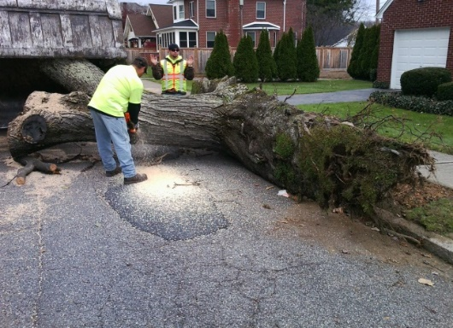
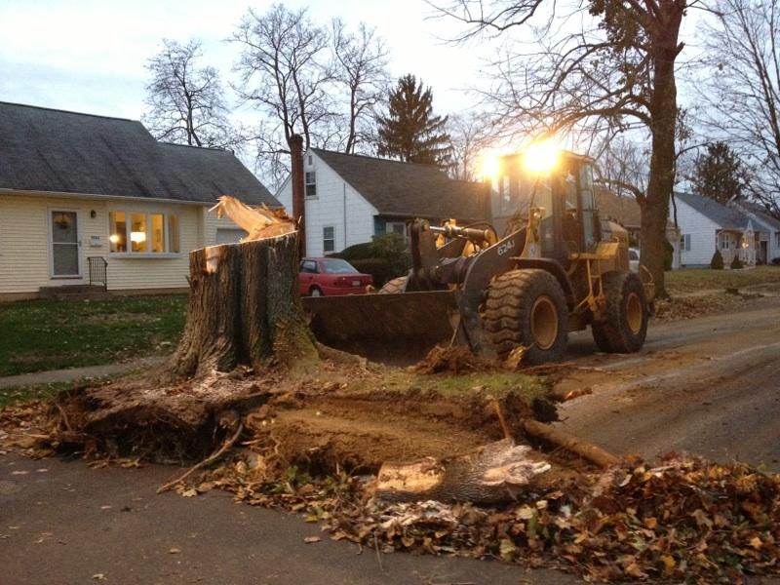
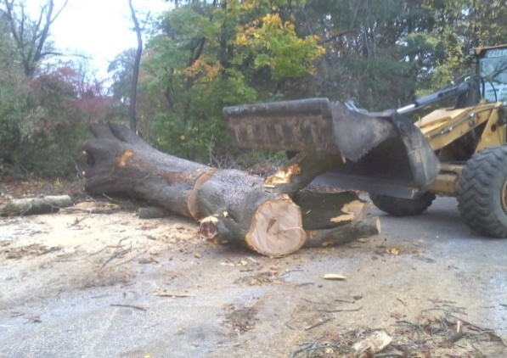
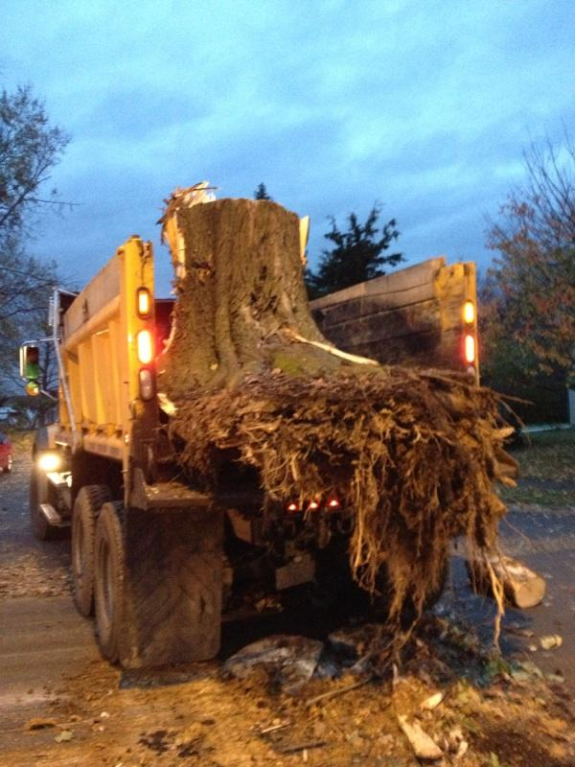
Challenges
Hurricane Sandy
Storm Cleanup

Slide 11
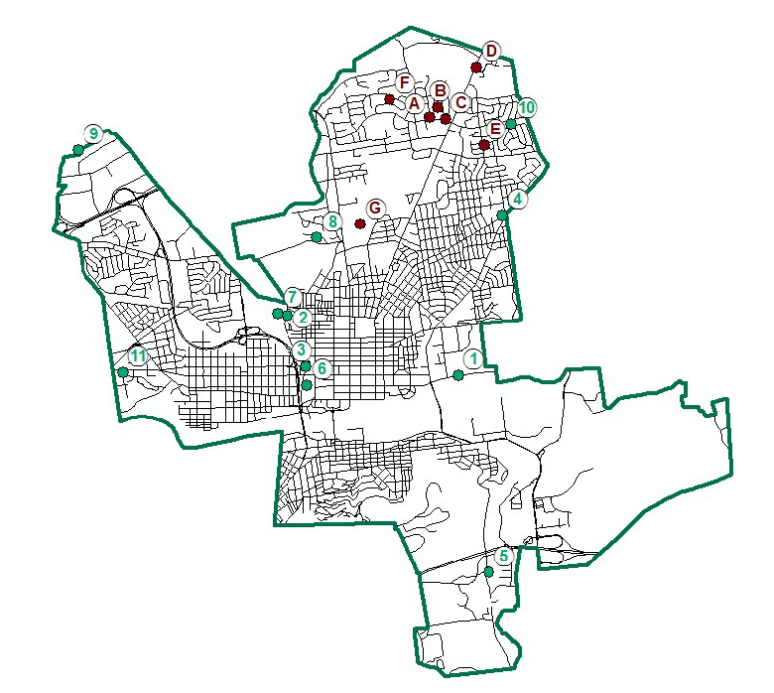
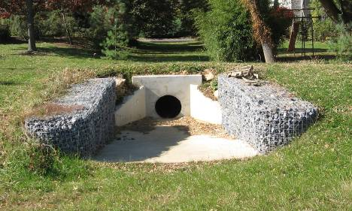
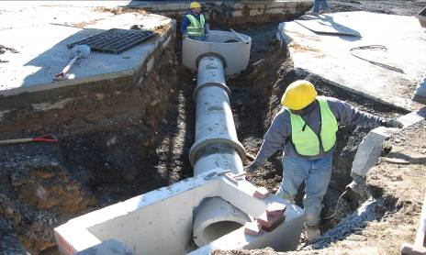
Stormwater Infrastructure
Feature | Quantity
Streets | 260 miles
Storm Sewer Pipe | 50+ miles
Open Swales | 17 miles
Storm Sewer Inlets | 3,000+
Detention Facilities | 76
Manholes | 1,651
Outfalls | 205
Other Structures | 87
City Operated Stormwater Controls

Slide 12
Current and Future Costs
Summary of Current Costs for Bethlehem, PA
 | FY20
Personnel | $954,514
Direct Costs | $312,613
Capital | $387,500
Totals | $1,654,627
Summary of Future Program Forecast for Bethlehem, PA
 | FY21 | FY22 | FY23 | FY24 | FY25 | FY26 | FY27 | FY28
Personnel | $1,340,931 | $1,367,749 | $1,538,325 | $1,826,375 | $1,858,712 | $2,057,613 | $2,379,480 | $2,422,879
Direct Costs | $515,487 | $462,755 | $829,470 | $714,384 | $729,471 | $776,670 | $838,278 | $806,103
Capital | $922,500 | $1,347,500 | $1,587,294 | $1,587,500 | $2,000,000 | $1,700,000 | $1,524,000 | $1,800,000
Totals | $2,778,917 | $3,178,004 | $3,955,294 | $4,128,259 | $4,588,183 | $4,534,283 | $4,741,757 | $5,028,982

Slide 13
Stormwater Utility
Both a fee and program for services, much in the same way that one pays for water or sewer service.
Fees are placed in an enterprise fund and can only be used for stormwater purposes.
Based on the demand for public stormwater systems, measured by the presence of impervious cover.
Provides opportunity to offset fees:
Credits

Slide 14
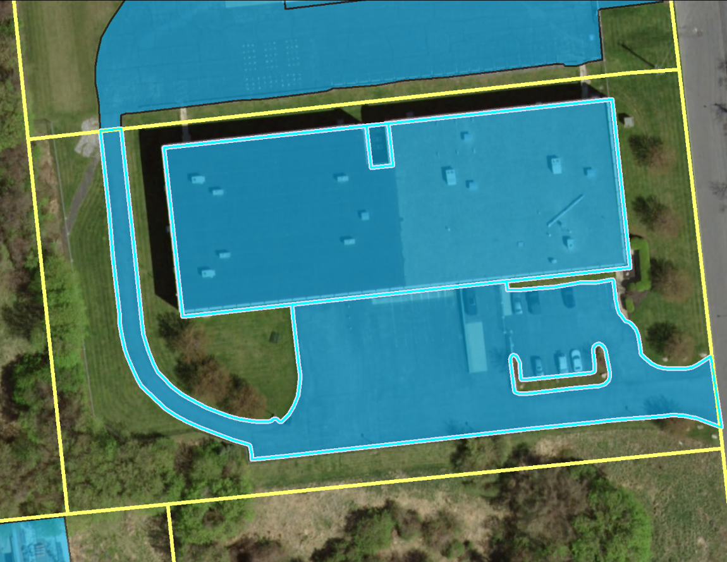
Stormwater Utility
How are Costs Distributed amongst Ratepayers?
Impervious area (IA) provides link between runoff and need for public services.

Slide 15
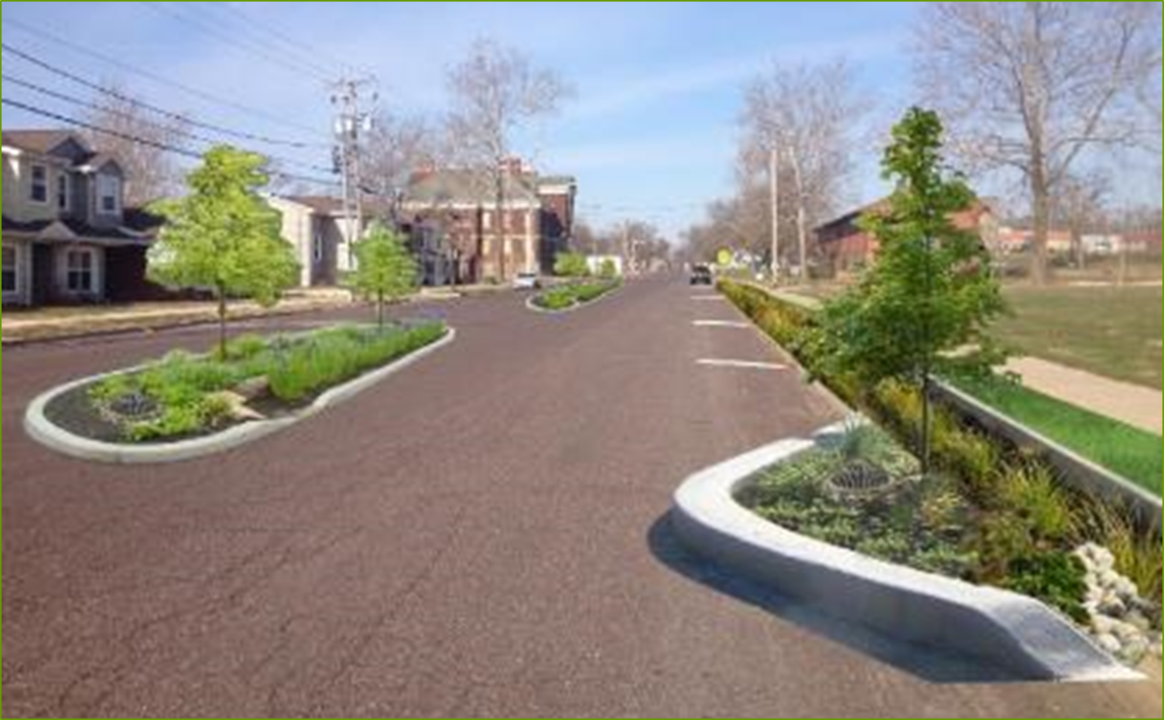
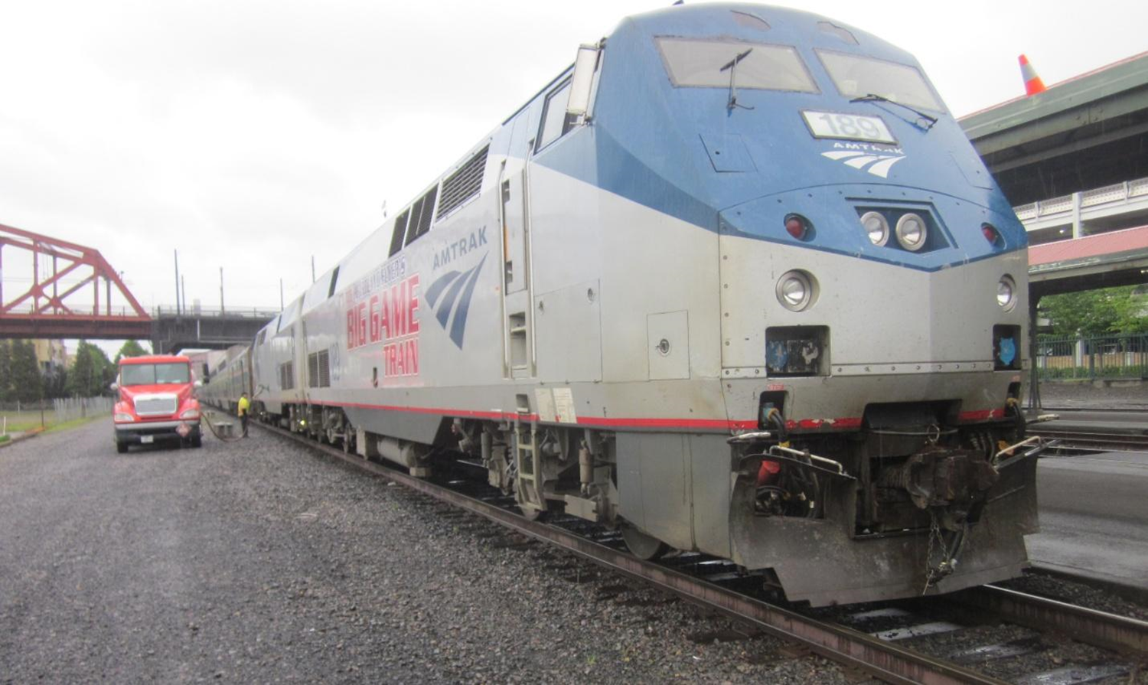
Stormwater Utility
What Parcels Are Not Charged?
Parcels not Charged:
Public ROW – City & State
Railroad Ballast – the tracks, but office buildings, depots, parking areas are charged

Slide 16
Stormwater Utility Development Process
Development Process
Develop a 10 Year Program Financial Forecast
Complete GIS analysis and rate structure options
Develop credit and incentive policies
Inform the public through meetings
Create billing file for property charges; test and integrate
Prepare ordinance for Council review and adoption
Develop customer service plan, training and implementation strategy

Slide 17
City of Bethlehem User Fee
Expectations, Goals, and Purpose
Develop a program to meet external (Federal and State) and internal goals.
Ensure that revenue is adequate to meet long-term needs and stable enough to do so in a cost-efficient manner.
Distribute program costs in an equitable manner. Everyone pays – including the City.
Implement an Enterprise Fund that ensures revenues are dedicated to stormwater management.
City’s Stormwater Management Program

Slide 18
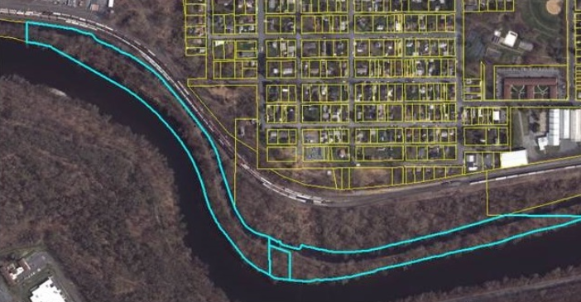
City of Bethlehem User Fee Development
Rate Base Methodology – Equivalent Residential Unit (ERU)
Based on median value of a sample of single-family residential parcel in Bethlehem which is 2,100 square feet.
Single-Family Residential
All single-family detached residential pay a recommended $60 per year

Slide 19
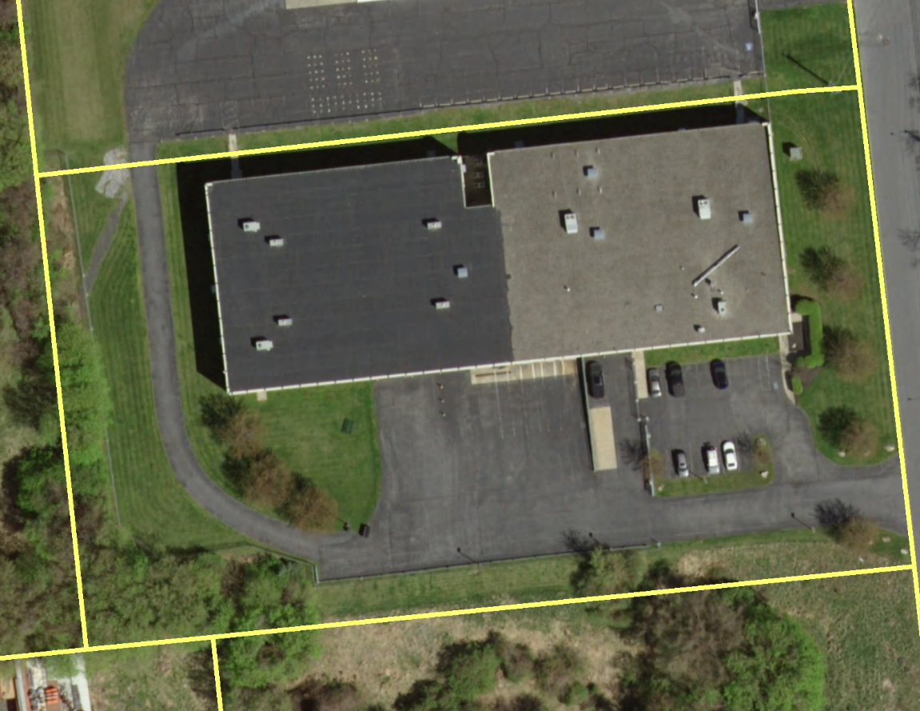
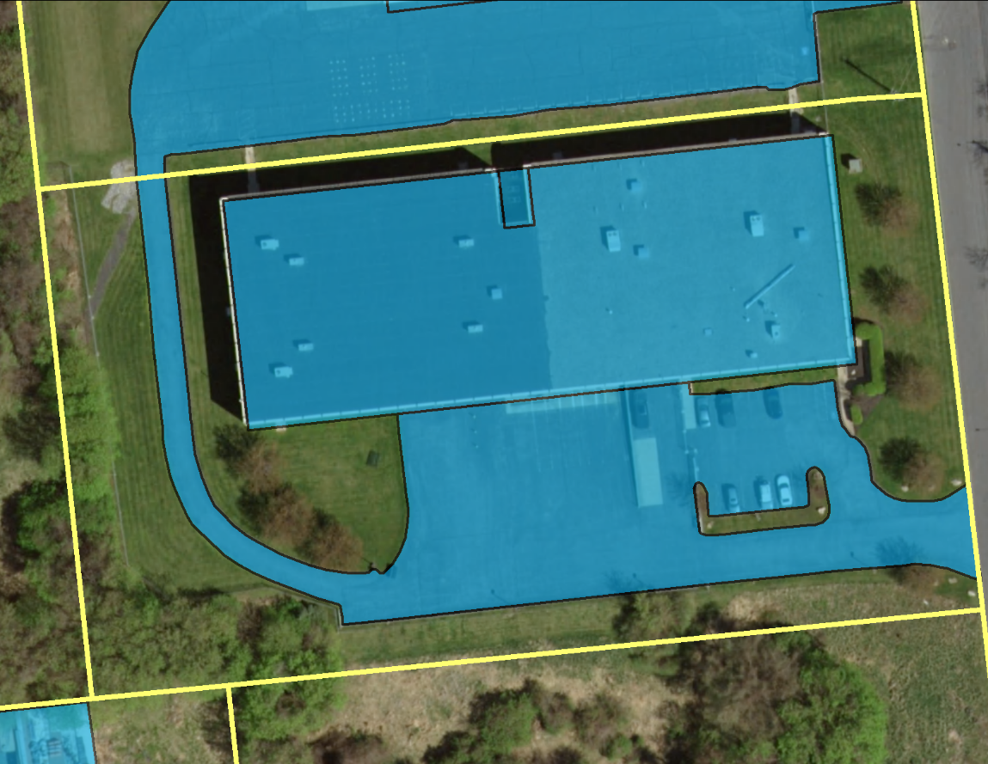
City of Bethlehem Rate Recommendation
Non-Single Family Residential & Commercial
A fee based on your property’s parcel, IA, & corresponding ERU
Each parcel fee based on per 2,100 square feet of IA regardless of land use
Example
Step 1 – Identify Parcel
Step 2 – Overlay with digitized Impervious Areas
Step 3 – Identify the Impervious Area for that Parcel
IA = 70,336 sq.ft
ERU = 70,336 sq.ft/2,100 sq.ft = 33
Fee/yr = 33 x $60 = $1,980.00

Slide 20
Other PA Stormwater Fees
Allentown
Easton
Mt Lebanon
Philadelphia
Meadville
Lancaster
Radnor
White Township
West Chester
City of Bradford
Hampden
Derry Township
Wyoming County Regional
West Goshen
Chester City
Scranton
Regional South Williamsport/Duboistown
Carlisle
Notes:
Meadville – Residential:$90 per single family detached; non-residential: $90/2,660 sf
Allentown – Residential: $20 per 500 SF; Non-Residential: $20 per 500 SF
Mount Lebanon – Residential: $96 per Single Family Detached; Non-Residential: $96 per 2,400 SF
White Township – Residential: $24 per Single Family Detached; Non-Residential: $24 per 3,700 SF
Easton PA – Residential: $81.00 a year ($6.75/mo.); Non-Residential $81 per 1,797 SF

Slide 21
Timeline
Fee Study Started – April 2019
City Implements Fee – January 2021
Ratepayers receive first bill – 1st Quarter 2021
City updates Stormwater Ordinance – December 2020

Slide 22
What to Expect - Fees
1st Quarter of 2021: First Utility Bill
Single Family Residential pays - $60/yr
Non-Single Family Residential – Fee based on ERU (2,100 sq.ft)
Commercial - Fee based on ERU (2,100 sq.ft)

Slide 23
Opportunities to Offset
Credits - City is currently working on developing a user fee credit structure

Slide 24
Questions?

